Slide 1
Playbook
A comprehensive guide for practitioners leveraging AI capabilities to facilitate new ways of working.
February 2026

Slide 2
Content
Playbook Overview & Framework Introduction
Section I: Practitioners Guide
Chapter I: AI–Empowered Problem–Solving
Chapter II: AI Tool / Solution Development & Agile Delivery
Section II: Sustainment
Section III: Organizational Change
Summary
1
2
3
4
5

Slide 3
Playbook Objectives
Purpose: This playbook is a comprehensive guide for practitioners leveraging AI capabilities to facilitate new ways of working.
✓ WHAT IT IS
✗ WHAT IT IS NOT
A practical framework for augmenting work with AI
A prescriptive, one–size–fits–all solution
Guidance on leveraging AI tools and methodologies
A replacement for your organization's AI policies
Set of illustrative examples with mock data for learning
A substitute for specific subject matter expertise
AI tool–agnostic approaches
A specific tool recommendation
Best practices for organizational change readiness
A guarantee of specific results
Understanding the scope and boundaries of this playbook ensures you get maximum value from its contents.

Slide 4




Guiding Principles
This playbook is designed to be generic and agnostic to any specific tools, processes, or organizational structures. As you apply these concepts, always align with your organizational policies and governance frameworks.
Broad Application
Principles apply across industries, company sizes, and transformation contexts
High–Level Methods
Playbook is guidance–driven and does not prioritize any specific methodology over another
Illustrative Examples
Mock data and scenarios demonstrate concepts without real data exposure
Policy Compliant
Always defer to your organizational data and AI governance policies

Slide 5
Introducing Agentic Operating Model Transformation (AOMT)
The Agentic Operating Model Transformation (AOMT) is a non–linear approach to operational transformations that leverages Artificial Intelligence and emerging technologies to move much farther and faster in the achieving an organization’s objectives.
The method based on two overarching principles:
Data First – ingest and interrogate the data landscape to reveal and verify evidence–based opportunities
AI First – design solutions that take full advantage of AI capabilities to make quantum gains in efficiency
Agentic Operating Model Transformation (AOMT) – Core Activities
Playbook Deep Dives:
Diagnose Data
SECTION I: Practitioners Playbook
Chapter I: AI Problem Solving
Prioritize Opportunities
Chapter II: Agentic Tool Dev & Agile Delivery
Design & Prototype
Implement Solutions
SECTION II: Perf. Mgmt. & Sustainment
Sustain Improvements
Change Management
SECTION III: Change Readiness
Activities are iterative and are frequently done in a concurrent manner to quickly yield “best fit” solutions.

Slide 6
Playbook Structure: Three Sections
Each section showcases exemplary methodologies, approaches, and techniques tied to the following key topics.
SECTION I: PRACTITIONERS PLAYBOOK
SECTION II: SUSTAINMENT
SECTION III: READINESS
Key topics:
Diagnose Data with AI
Prioritize Opportunities
CHAPTER I: AI–Empowered Problem Solving
CHAPTER II: AI Tool / Solution Development & Agile Delivery
Key topics:
Design / Prototype AI Tools
Agile Delivery Approach
Key topics:
Sustain Improvements
Manage Performance
Performance Mgmt. & Sustainment
Organizational Change Management
Key topics:
Enable Org. Readiness
Plan Communications

Slide 7
SECTION 1: PRACTITIONERS GUIDE
SECTION 1: PRACTITIONERS GUIDE
Section Chapters:
Chapter I: AI Problem Solving
Chapter II: Agentic Tool Dev
Playbook Deep Dives:
SECTION I: Practitioners Guide
Chapter I: AI Problem Solving
Chapter II: Agentic Tool Dev & Agile Delivery
SECTION II: Perf. Mgmt. & Sustainment
SECTION III: Change Readiness

Slide 8
Chapter I: AI–Empowered Problem Solving
SECTION 1: PRACTITIONERS GUIDE
Section Chapters:
Chapter I: AI Problem Solving
Chapter II: AI Tool Dev

Slide 9
AI–Empowered Problem Solving
ILLUSTRATIVE
Chapter I: AI Problem Solving
This chapter focuses on leveraging AI to diagnose organizational challenges and identify key opportunities through data–driven insights.
Phase 1 (iterative process)
Data Ingestion & Discovery
AI–Assisted Diagnosis
Synthesis for Opportunities
Connect to existing data sources and allow AI to surface patterns, anomalies, and opportunities hidden within operational data.
Use intelligent analysis to validate hypotheses, challenge assumptions, and reveal evidence–based insights.
Translate key findings into a coherent set of opportunities as concrete, actionable value levers.
Phase 2
Opportunity Prioritization
Rank and prioritize the identified opportunities based on impact, feasibility, time criticality, and strategic alignment.

Slide 10
Phase 1: Diagnosis
Phase 1
ILLUSTRATIVE
Chapter I: AI Problem Solving
Diagnose activities are iterative and continue until the solutions team is comfortable that the problem has been distilled to its most exhaustive level with discrete opportunities identified.
PHASE 1: DIAGNOSIS
PHASE 2: PRIORITIZATION
PROBLEM STATEMENT
Create an initial problem statement and refine as needed
ISSUES TREE
Develop an issues tree and prune branches to identify focus areas
1
2
DATA ANALYSIS
& SYNTHESIS FOR OPPS
Analyze the data, review, validate, refine, and identify opportunities
6
PRIORITIZATION
Prioritize opportunities identified in Phase 1
DATA REQUEST
& INGESTION
Start data ingestion and collection; track requests
3
DATA ANALYSIS PLAN
Plan for data analysis approach and methodology; refine as needed
5
4
HYPOTHESES
Develop initial hypotheses to test and iterate based on findings
Note: This chapter walks through each topic step by step, using a case study to bring the concepts to life through examples.

Slide 11


Phase 1: Diagnosis | Initial Problem Statement
1. Problem Statement
Phase 1
ILLUSTRATIVE
Chapter I: AI Problem Solving
1
2
6
3
5
4
A draft problem statement can be useful in creating the initial data request. Characterizing the issue in a structured way will help ensure that the first data request is broad enough to provide useful insights. An initial Problem Statement should include the following elements:
DESCRIPTION
A high–level summary of the “problem to be solved”, in everyday terminology
DECISION MAKERS
Who are the accountable parties who will be making decision on improvement options
BOUNDARIES
What aspects of the problem are off–limits, or what regulations could constrain solutions
TIMEFRAME
How will effective solutions be reflected in business metrics (i.e., financial, operational, quality)
CUSTOMERS
A list of all the end–users, intermediaries and leaders who are impacted by the problem
DECISION DRIVERS
What factors will likely influence decision makers (i.e., adjacent concerns, conflicting agendas)
SUCCESS MEASURES
How will effective solutions be reflected in business metrics (i.e., financial, operational, quality)
Important: This is an iterative, data–driven process. As additional data is ingested, assumptions will be validated, root causes will be surfaced, and hypotheses will be tested and refined accordingly.

Slide 12
Phase 1: Diagnosis | Initial Problem Statement – example
1. Problem Statement
Phase 1
ILLUSTRATIVE
Chapter I: AI Problem Solving
1
2
6
3
5
4
Stated Business / Operations Concern: Metro Cable has an upcoming Rate Case with the Public Service Commission (PSC) requesting a 7% basic fee increase for customers. The PSC has a history of reasonableness regarding rate increase for economic reasons when customer satisfaction is high. Currently, Metro Cable customer satisfaction scores are low (55/100 ACSI). Metro Cable leadership in concerned that the Rate Case will fail unless customer satisfaction rating meet or exceed ratings for other utilities (i.e., gas, electric, phone) which historically have been higher (74/100 ACSI).
Initial Problem Statement:
Description: Metro Cable has comparatively low customer satisfaction and is looking to improve customer satisfaction ratings.
Customers: Business and Residential Cable Customers Public Service Commission | Boundaries: Basic Service Pricing Contracts with Content Providers Current Customers
Decision Makers: Metro Cable Executive Committee | Success Measures: Customer Satisfaction Ratings Rate Case Approval
Decision Drivers: Capital Investment Constraints Regulations | Time Frame: 12 months until next PSC Rate Case hearing
Note: An Initial Problem Statement is a first glance structuring of the stated issue, this first version will serve as a starting point of creating an Issues Tree and can be used to inform the Initial Data Request. The Problem Statement will likely be revised over time as additional insights are collected.

Slide 13
Phase 1: Diagnosis | Problem Statement Evolution
1. Problem Statement
Phase 1
ILLUSTRATIVE
Chapter I: AI Problem Solving
1
2
6
3
5
4
Problem Statement
An initial problem statement can be derived from early conversations about the issue to be addressed
This draft version can be used as input to render a “first pass” data request
Note: The process of defining the problem and compiling data is an iterative process. Subsequent slides will focus on creating an Issues Tree to further focus improvement efforts. Based on the completed Issues Tree, problem statement and data request revisions are likely.
There is no “magic” number of cycles needed to refine initial Problem Statements; however, it is unlikely that the initial Problem Statement will remain unrevised once data is fully reviewed.
Teams should challenge the Working Problem Statement along will all assumptions and Hypotheses throughout the improvement effort and solution prototyping.
Start
Initial Problem Statement
Initial Data Request
Analysis + Data Interrogation
List of Opportunities
Request for Additional Data
Refined Problem Statement
Analysis + Data Interrogation
Working Problem Statement
Additional Questions
Opportunities Identified

Slide 14
Phase 1: Diagnosis | Issues Tree – disaggregation of the issues
2. Issues Tree
Phase 1
ILLUSTRATIVE
Chapter I: AI Problem Solving
1
2
6
3
5
4
Issues Tree
An Issues Tree is a structured approach of breakdown an issue into its logical parts.
Typically depicted horizontally, the trunk of the tree is the Problem Description for the Problem Statement
Figuratively speaking, branches, sub–branches emerge from the trunk and continue breaking down into twigs and leaves
Each level of an Issue Tree breaks down a higher–level component into its sub–component parts.
For example:
Inventory Volume is a function of:
Inbound Replenishment
Outbound Fulfillment
Inbound Replenishment is a function of:
Order Timing
Vendor Shipping
Notes:
Creating an Issues Tree should be a “team exercise” so that multiple perspectives are considered and can be captured
Constructing an Issues Tree should be an exhaustive and exclusive exercise where time is taken to capture all the components of an issue while ensuring that the branches are exclusive (i.e., not overlapping)

Slide 15

Phase 1: Diagnosis | Issues Tree – example
2. Issues Tree
Phase 1
ILLUSTRATIVE
Chapter I: AI Problem Solving
1
2
6
3
5
4
Metro Cable Issues Tree
Channel Availability
Video Quality
Customer satisfaction ratings for Metro Cable represent an aggregation of many factors that influence the customer experience.
Breaking down the issue into its component parts using an Issue Tree to capture all aspects of the problem will helps ensure that Data Requests are both well– focused and comprehensive.
Cable TV
Speed
Internet
Reliability / Uptime
Phone Service
Audio Quality
Product/Service Offerings
Emergency Calls
Low Customer Satisfaction Rating
Basic Service
Pricing
Packages
Entertainment
Digital
Account Log–in
Search Function
Customer Support
Confirmation
Web–page
Automated Prompts
Telephone
Appointment Availability
Note:
Boundaries listed in the Problem Statement cite Basic Service Fees are not to be considered, and that efforts should focus on Current Customers. Therefore, those branches are not broken down further in this initial version of the Issues Tree. Subsequent information may suggest that these branches be reconsidered with Metro Cable leadership approval.
Representative
Length of Installation Call
On–Site
New Service Installation
Service Scheduling
At–home Wait Times
Repair Service Calls
Issue Resolution
Disconnections

Slide 16





Phase 1: Diagnosis | Data Request: Understanding the Data Landscape
3. Data Request
Phase 1
ILLUSTRATIVE
Chapter I: AI Problem Solving
1
2
6
3
5
4
Following the Issues Tree, we aim to understand what data exists, where it lives, and how it can be used to validate, quantify, and target the identified issues, informing a focused data request list and an effective data collection process.
Data Origins
Data Platforms
Data Engineering
Data Use
Unstructured data in the form of emails, text messages and physical documentation.
Applications, systems, and databases in which data is ingested and store for subsequent use
Cleansing, editing, deduplication, standardization, integration, aggregation and other activities the render ingested data into usable forms
Business processing, analysis, reporting and other end states of data flowing through the organization
Structured data in the form of data feeds, on–line forms, and downloads.
Data First investigations use data logs and system information to follow transactional data through the organization’s systems and processes looking for anomalies and trends that signal inefficiencies and opportunities for improvement.

Slide 17
Phase 1: Diagnosis | Data Request – example
3. Data Request
Phase 1
ILLUSTRATIVE
Chapter I: AI Problem Solving
1
2
6
3
5
4
A critical part of Diagnose Data activities is ingesting all pertinent data for analysis. AOMT Data Requests differ from traditional requests because in additional to typical transaction data, we are also seeking machine/system logs and unstructured data in the request.
Digital Data Request Tracker is a flexible agent that can be used to build, present, and manage data requests.
Typically, the process using this tool includes:
Create/upload Requests List (either upload an existing one or generate with AI)
Review and Edit the Requests List as needed (add/remove as well as validate tasks, owners, status, dates and resolve any overlapping requests)
Upload Received Files to the Tracker (AI–enabled tracking)
Review the latest status in the Tracker Dashboard
Extract Status Data (excel–based full tracker and/or PPT data request status update deck) using Status Update Generators
Iterative review and data collection process to close all outstanding items collaborating with the team
Note: Not only does AOMT produce AI enabled tools to solve business issues, but AI enabled tools are also used throughout AOTM activities to increase the speed and quality.

Slide 18
Phase 1: Diagnosis | Data Request – example continued
3. Data Request
Phase 1
ILLUSTRATIVE
Chapter I: AI Problem Solving
1
2
6
3
5
4
Using the AI Tool, a Data Request can be generated based on the Initial Problem Statement. Later as more details are known the Data request can be update to include additional insights.
1
Based on the Initial Problem Statement, the AI Tool recommends requesting a comprehensive data set across the full spectrum of potential contributors to low levels including billing and network operations.
2
Based on what the team has learned about the data landscape, Issues Tree and Initial Hypotheses, the team should refine the Data Request to ensure proper coverage while avoiding assemblage of less relevant data.

Slide 19


Phase 1: Diagnosis | Data Request: Risks & Considerations
3. Data Request
Phase 1
ILLUSTRATIVE
Chapter I: AI Problem Solving
1
2
6
3
5
4
AI Analysis tools (discussed later) can render multiple analyses quickly; however, when making data requests team should consider practicality of the request based on the problem to be solved.
Overly Comprehensive
Too Limited
Pros
In general, a comprehensive data request is preferred as the subsequent analysis will reveal hidden contributors to the problem, or areas of significance that had not been initially considered.
Getting more data earlier can help eliminate multiple subsequent requests that may prove frustrating for both the data team and those analyzing the data.
Pros
Highly focused data requests can be fulfilled more rapidly, allowing teams to reveal opportunities and pursue quick win solutions.
Fewer data sets simplifies data engineering and allows teams to quickly engage in analysis to validate Hypotheses.
Cons
A too tightly focused data request can lead teams away from larger opportunities or require subsequent data request that may slow down progress
Analyzing the problem from a limited viewpoint can reduce the ability to identify potential unintended consequences of proposed solutions
Team can unwittingly succumb to missing the forest of opportunities by looking to intensely at a single tree.
Cons
Large data requests, especially from multiple sources (omni–channel) may delay data availability
Conducting data engineering on multiple data sets can consume valuable time and may not enhance the analysis results
Teams can unwittingly succumb to analysis paralysis and miss out on opportunities to secure quick wins
Crafting an appropriate data request that balances these consideration is the “art” behind the “science”.

Slide 20
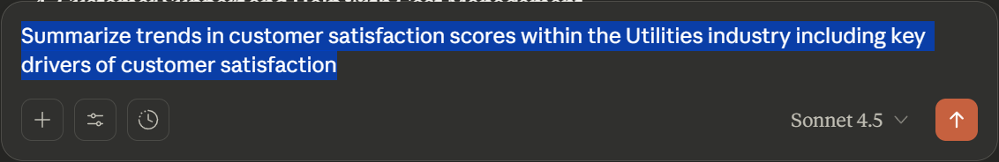
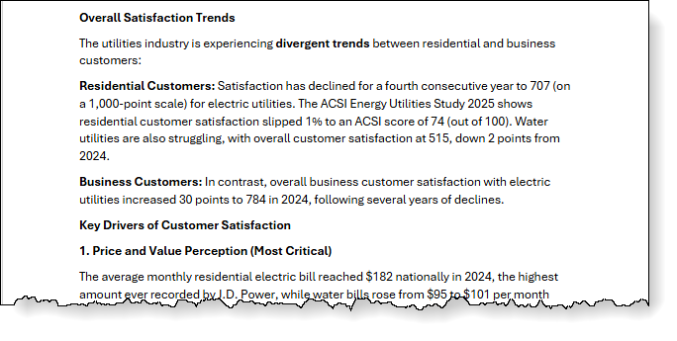
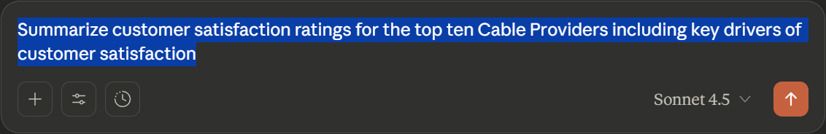
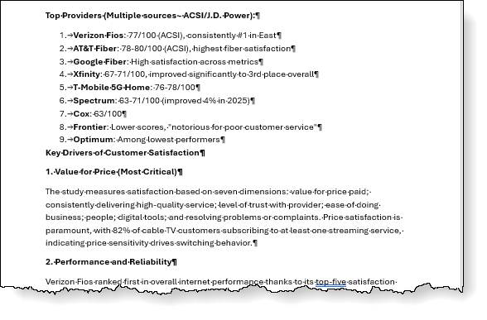
Phase 1: Diagnosis | AI Enabled Research – example
4. Hypotheses
Phase 1
ILLUSTRATIVE
Chapter I: AI Problem Solving
1
2
6
3
5
4
Employing AI Tools to conduct basic research related to the Problem Statement can help confirm and/or reshape initial impressions regarding the problem to be solved.
Prompt:
Initial characterizations of the Metro Cable situation appear to be valid based on some simple AI prompts:
Current Customer Satisfaction ratings are well below the Utilities Industry average (74/100)
Likewise, amongst cable providers, current customer satisfaction ratings for Metro Cable (55/100) place it at the bottom of peers
Prompt:
Important: AI tools can make mistakes. Entering the same prompt into multiple AI tools or prompting a second AI tool to validate the output of the first tool can help reduce risks. Always validate key facts before using the AI output for critical decision making.

Slide 21
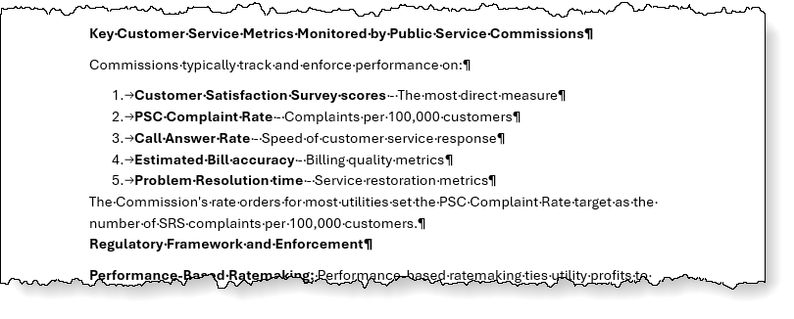
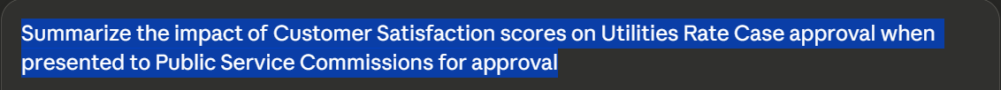
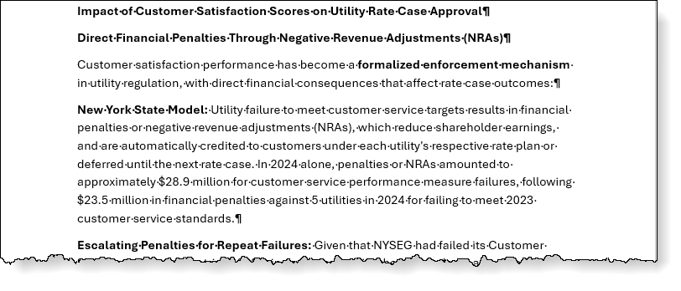
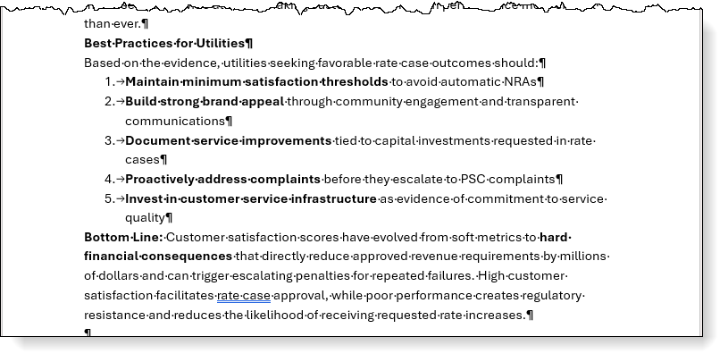
Phase 1: Diagnosis | AI Enabled Research – example continued
4. Hypotheses
Phase 1
ILLUSTRATIVE
Chapter I: AI Problem Solving
1
2
6
3
5
4
Another simple AI prompt suggests Metro Cable concerns about current customer satisfaction ratings potentially having a negative impact on PSC approval of the upcoming rate case.
Prompt:
Note:
In addition to relevant details regarding rate case approvals¹ and customer satisfaction, this output also offers insights on key metrics² and PSC considerations that will help inform how solutions (once implemented) can be included in the rate case documentation³ to increase the likelihood of a favorable outcome⁴.
1
2
3
4
Important: AI tools can make mistakes. Entering the same prompt into multiple AI tools or prompting a second AI tool to validate the output of the first tool can help reduce risks. Always validate key facts before using the AI output for critical decision making.

Slide 22
Phase 1: Diagnosis | Initial Hypotheses (Day 1 Thinking)
4. Hypotheses
Phase 1
ILLUSTRATIVE
Chapter I: AI Problem Solving
1
2
6
3
5
4
Based on details in the problem statement and some basic research teams should begin developing an initial set of Hypotheses which can help shape the Data Analysis Plan.
Comparing the results of basic research against the initial Issues Tree can suggest those sub–components that are likely contributors to the overall problem.
For each identified branch, the team should create both a Null Hypothesis and an Alternative Hypothesis which can be used in subsequent data analysis.
H₀ – Null Hypothesis | Changes in the characteristics of this sub–component will have “no effect” or will make “no difference” relative to the overall problem.
H_{a} – Alternative Hypothesis | Changes in the characteristics of this sub–component cannot be proven to have “no effect” or will make “no difference” relative to the overall problem. Essentially “accepting” the Alternative Hypothesis indicates that the sub–component might be a contributor to the problem.
Note: To be consistent with the principles of Hypothesis Testing, the Null Hypothesis assumes that there is “no effect”. Testing the Null Hypothesis attempts to “prove” that there is “no effect”. If the team cannot prove there is “no effect” then by tradition the Null Hypothesis is rejected, and the team accepts the Alternative Hypothesis which in a practical sense suggests that the sub–component is worth looking at as a contributor to the overall problem.

Slide 23
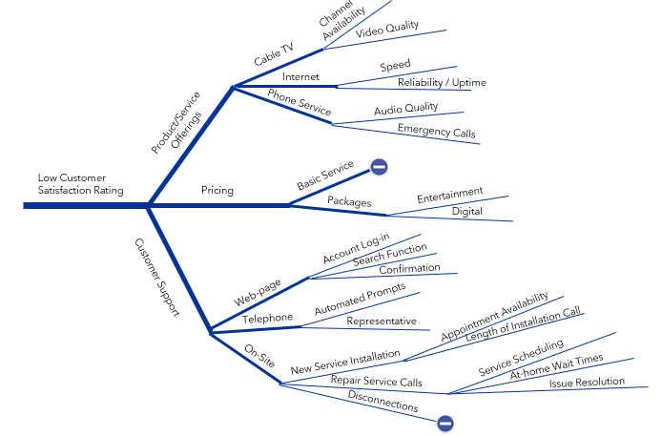
Phase 1: Diagnosis | Initial Hypothesis (Day 1 Thinking) – example
4. Hypotheses
Phase 1
ILLUSTRATIVE
Chapter I: AI Problem Solving
1
2
6
3
5
4
The submitted Data Request will look at several branches of the Issues Tree and subsequent data analysis will reveal which branches are most impactful. Basic research and previous service industry experience prompts the team’s Day 1 Thinking to be curious about the Customer Support branch and specifically New Service Installation and Repair Service Calls.
The team develops a set of Hypotheses to test against requested data:
Issue | H₀ – Null Hypothesis | H_{a} – Alternative Hypothesis
Appointment Availability | Inability to get a desired appointment time for installation does not impact Customer Satisfaction | Getting a desired appointment time for service installation may have an impact on customer satisfaction
Length of Installation Call | The length of the installation call does not have an impact on Customer Satisfaction | Lengthy installation calls may have an impact on Customer Satisfaction
Service Scheduling | Inability to schedule a convenient time for a service visit does not impact Customer Satisfaction | Scheduling a convenient time for a service visit may have an impact on Customer Satisfaction
At–home Wait Times | Time required to wait at–home for a service visit does not impact Customer Satisfaction | Time required to wait at–home for a service visit may have an impact on Customer Satisfaction
Issue Resolution | Issue resolution during a service visit does not have impact on Customer Satisfaction | Issue resolution during a service visit may have an impact on Customer Satisfaction
Note: Accepting the Alternative Hypothesis does not confirm a cause–and–effect relationship but can used to narrow the list of contributing factors to those that are more highly likely to have a role in solving higher level issues.

Slide 24
Phase 1: Diagnosis | Refined Data Request – example
4. Hypotheses
Phase 1
ILLUSTRATIVE
Chapter I: AI Problem Solving
1
2
6
3
5
4
A revised data request will reflect an edited form of the AI generated request with additional requested data that aligns to initial Hypotheses.
1
Some of the requests indicated by the AI Tool may include other types of requests (i.e., meetings interview requests, etc.) as indicated in the “Request Type” column.
2
After reviewing the AI Tool recommendations, the team may edit some requested items to include additional data dimensions to reflect areas of interest aligning with the initial Hypotheses.
3
Comparing AI Tool recommendations with the Issues Tree, the team may identify gaps or additional desired data that might reveal deeper layers of the problem. Additional data requests can be added as part of the editing process before submitting the Data Request.

Slide 25
Phase 1: Diagnosis | Data Analysis Plan
5. Data Analysis Plan
Phase 1
ILLUSTRATIVE
Chapter I: AI Problem Solving
1
2
6
3
5
4
While waiting for responses to the initial Data Request, teams can begin planning for data analysis based on the Hypotheses to be tested by creating a Data Analysis Plan.
A well–crafted Data Analysis Plan will conclude:
Issue – the branch of the Issues Tree against which the Hypotheses apply
H₀ – the null hypothesis (“no effect”)
H_{a} – the alternative hypothesis (“no effect” can not be proven)
Data Source – what data in the Data Request will be used for the analysis
Planned Analysis – what analysis is planned to test the hypothesis
Lead – who is responsible for conducting the analysis
Issue | H0 | Ha | Data Source | Planned Analysis | Lead

Slide 26
Phase 1: Diagnosis | Data Analysis Plan – example
5. Data Analysis Plan
Phase 1
ILLUSTRATIVE
Chapter I: AI Problem Solving
1
2
6
3
5
4
While waiting for responses to the initial Data Request, teams can begin planning for data analysis based on the Hypotheses to be tested by creating a Data Analysis Plan.
Issue | H₀ | H_{a} | Data Source | Planned Analysis | Lead
Appointment Availability | Inability to get a desired appointment time for installation does not impact Customer Satisfaction | Getting a desired appointment time for service installation may have an impact on customer satisfaction | Call Center data logs Web site data files Dispatch data logs Work order system data Customer complaint logs | Scheduled Installations vs work order completion Changes to originally scheduled dates Lag time between first contact and scheduled date Customer complaints | Chris Z.
Length of Installation Call | The length of the installation call does not have an impact on Customer Satisfaction | Lengthy installation calls may have an impact on Customer Satisfaction | Work order system data Customer complaint logs | Order start to finish times Orders against complaints | Abigail G.
Service Scheduling | Inability to schedule a convenient time for a service visit does not impact Customer Satisfaction | Scheduling a convenient time for a service visit may have an impact on Customer Satisfaction | Call Center data logs Web site data files Dispatch data logs Work order system data Customer complaint logs | Lag time between first contact and service visit Dry runs – customer not home Reschedules Cancelled orders Customer complaints | Yaz K.
At–home Wait Times | Time required to wait at–home for a service visit does not impact Customer Satisfaction | Time required to wait at–home for a service visit may have an impact on Customer Satisfaction | Dispatch data logs Work order system data Customer complaints | Service completion time within scheduled service window Reschedules Cancelled orders Customer complaints | Sam N.
Issue Resolution | Issue resolution during a service visit does not have impact on Customer Satisfaction | Issue resolution during a service visit may have an impact on Customer Satisfaction | Work order system Customer complaints | Work not completed –reason codes Reschedules for 2–Tech crews Customer complaints | Jamie W.

Slide 27
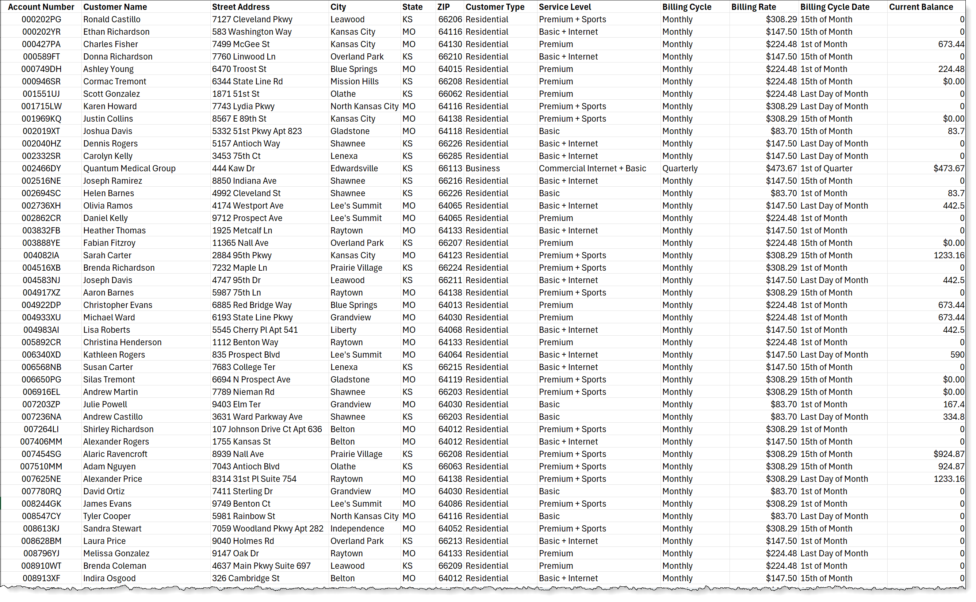
Phase 1: Diagnosis | Data Analysis – example
6. Data Analysis & Synthesis for Opps
Phase 1
ILLUSTRATIVE
Chapter I: AI Problem Solving
1
2
6
3
5
4
Iterative Analysis
Data Requests are often fulfilled in pieces with easy to obtain data available first and other datasets arriving over the course of a few days.
Because Data Diagnosis is non–linear and iterative, AI enabled analysis can begin as soon as the first data set is available.
When interrogating data, there are no “bad” questions, and even if the analysis doesn’t directly align with initial Hypotheses, the results may produce interesting insight that can guide the team’s later work.
The first available Metro Cable dataset is Customer Account Data. The team can conduct preliminary analysis on this data to gain insights while other datasets are being compiled.

Slide 28
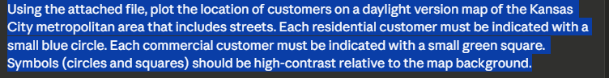
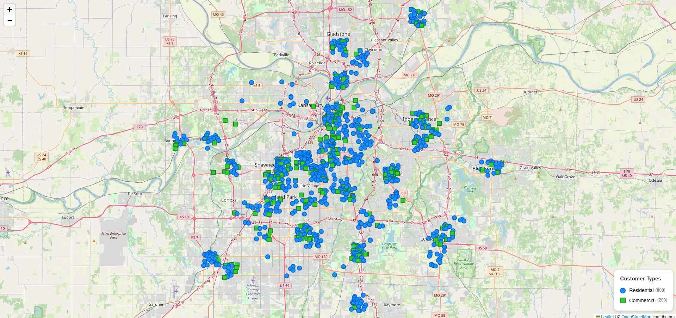
Phase 1: Diagnosis | Data Analysis: “Visualization” – example
6. Data Analysis & Synthesis for Opps
Phase 1
ILLUSTRATIVE
Chapter I: AI Problem Solving
1
2
6
3
5
4
Prompt:
Data Visualization
A good early analysis is to make the data visual.
Having data in a visual format can help teams understand key dynamics of the operations that might not be readily apparent in the dataset.
In this case, the Team is interested in understanding the geographic distribution of Metro Cable customers.
These insights may prove valuable in future analysis.
KC_Customer_Map.html
Using AI enabled analysis tools, the Team can quickly plot customer locations on a map of the service area – in the past, such analysis would have required specialized mapping tools and significant effort on the part of the team.

Slide 29
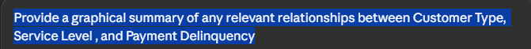
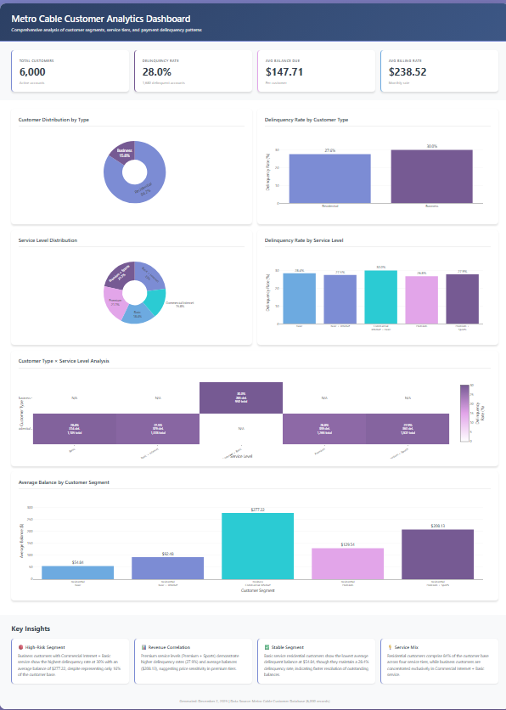
Phase 1: Diagnosis | Data Analysis: “Visualization” – example
6. Data Analysis & Synthesis for Opps
Phase 1
ILLUSTRATIVE
Chapter I: AI Problem Solving
1
2
6
3
5
4
Prompt:
Data Visualization
AI enabled analysis can be thought of as “curiosity enabled analysis” using AI tools.
Traditionally, due to the length of time required to complete manual data analysis, teams would prioritize which areas to address.
Labor intensive manual data analysis often meant the team was time–constrained and unable to full interrogate the data.
In this case, the teams seeks to understand more about late and delinquent customer accounts. Using a simple prompt, the team can expose any potential relationships between customer type, or service level and account delinquency.
Note: Even when the AI enabled data analysis doesn’t show a significant relationship, this type of quick analysis can be used to narrow the focus of subsequent analysis.
Metro_Cable_Payment Dashboard.html
Important: AI tools can make mistakes. Entering the same prompt into multiple AI tools or prompting a second AI tool to validate the output of the first tool can help reduce risks. Always validate key facts before using the AI output for critical decision making.

Slide 30
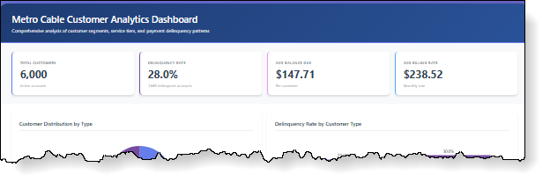
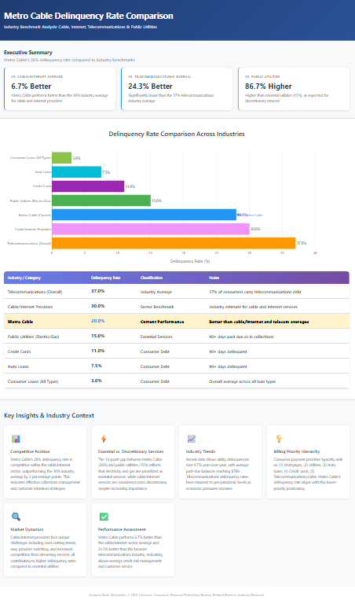
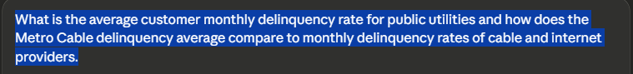
Phase 1: Diagnosis | Data Analysis: “Curiosity Analysis” – example
6. Data Analysis & Synthesis for Opps
Phase 1
ILLUSTRATIVE
Chapter I: AI Problem Solving
1
2
6
3
5
4
One statistic in the previous Customer Payment Analysis stood out to the team and initiated a follow–up AI enabled analysis prompt.
Prompt:
Results from the AI Analysis suggest that Metro Cable’s delinquency rate is slightly better than the average for cable and internet providers.
While this high–level analysis didn’t reveal an anomaly, the team will make a note of delinquency rate and look for cross–connections throughout subsequent analysis.
Metro_Cable_Payment Industry_Comparison.html
Important: AI tools can make mistakes. Entering the same prompt into multiple AI tools or prompting a second AI tool to validate the output of the first tool can help reduce risks. Always validate key facts before using the AI output for critical decision making.

Slide 31
Phase 1: Diagnosis | Data Analysis – example
6. Data Analysis & Synthesis for Opps
Phase 1
ILLUSTRATIVE
Chapter I: AI Problem Solving
1
2
6
3
5
4
The next data the team receives is from Human Resources and the Finance Department:
List of all employees with labor rates
Current month P&L with forecast and year–to–date details
The team can conduct additional “curiosity analysis” while waiting for the data from the customer service team.
Metro Cable Employees.xlsx
Metro_Cable_PL_Nov2025.xlsx

Slide 32
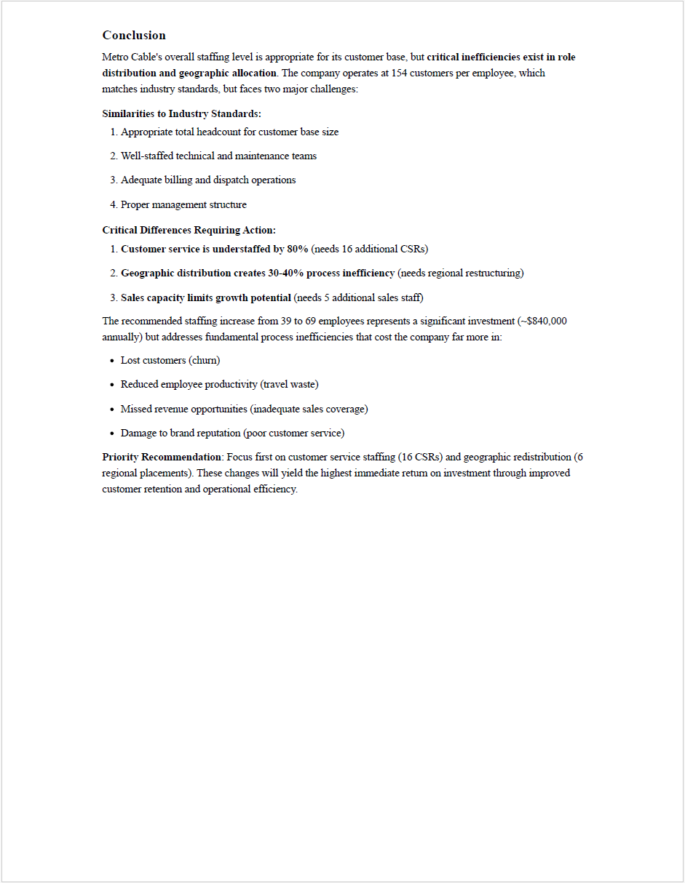
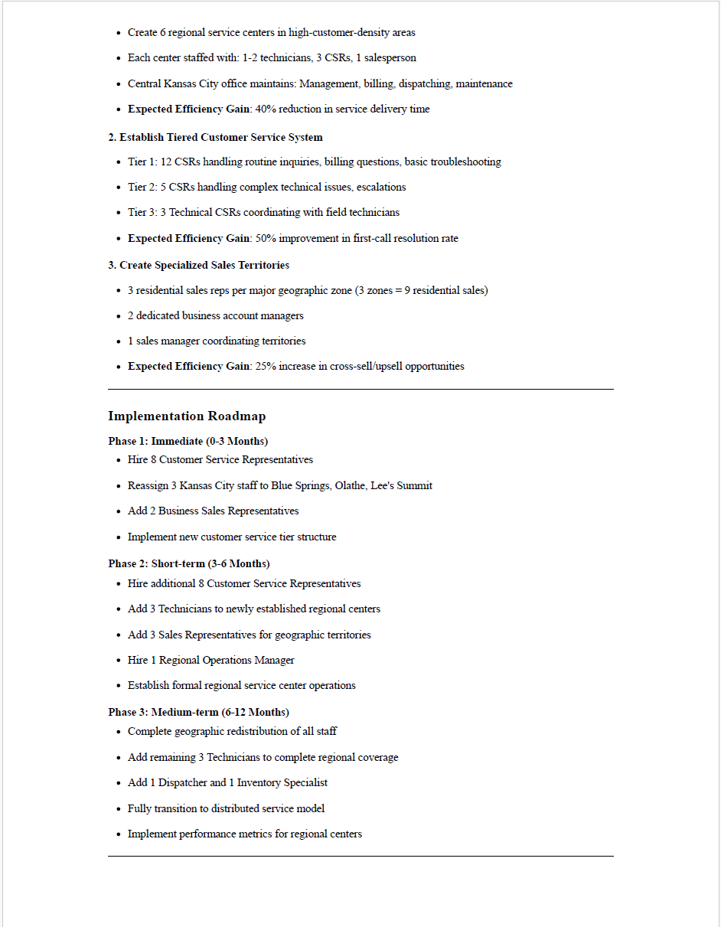
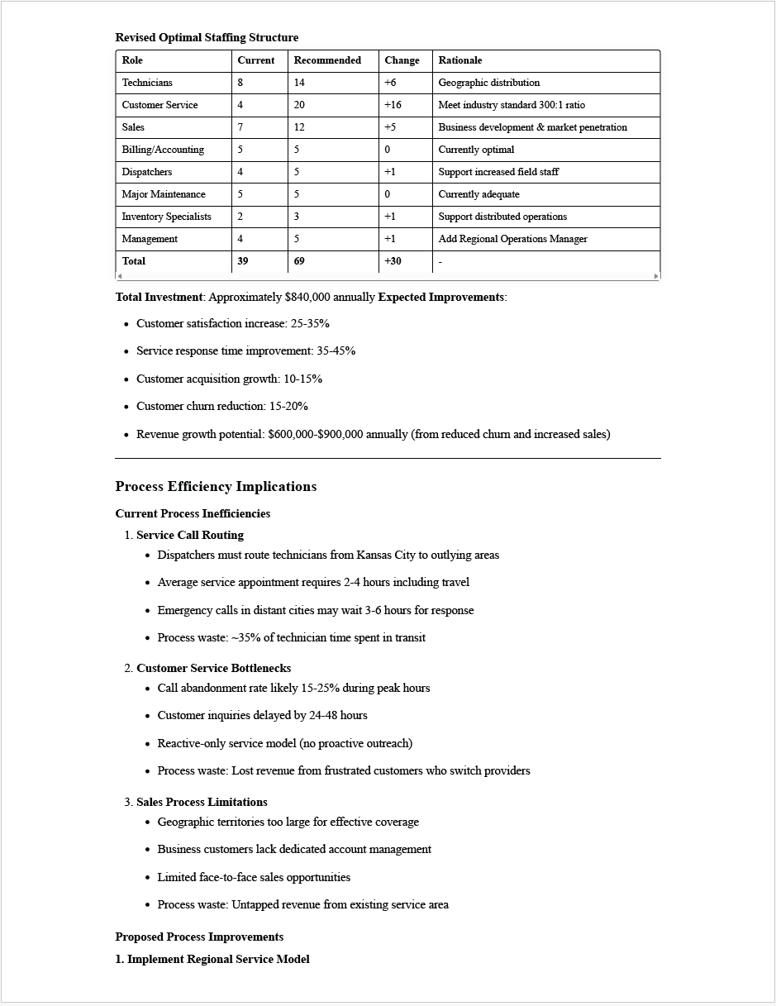
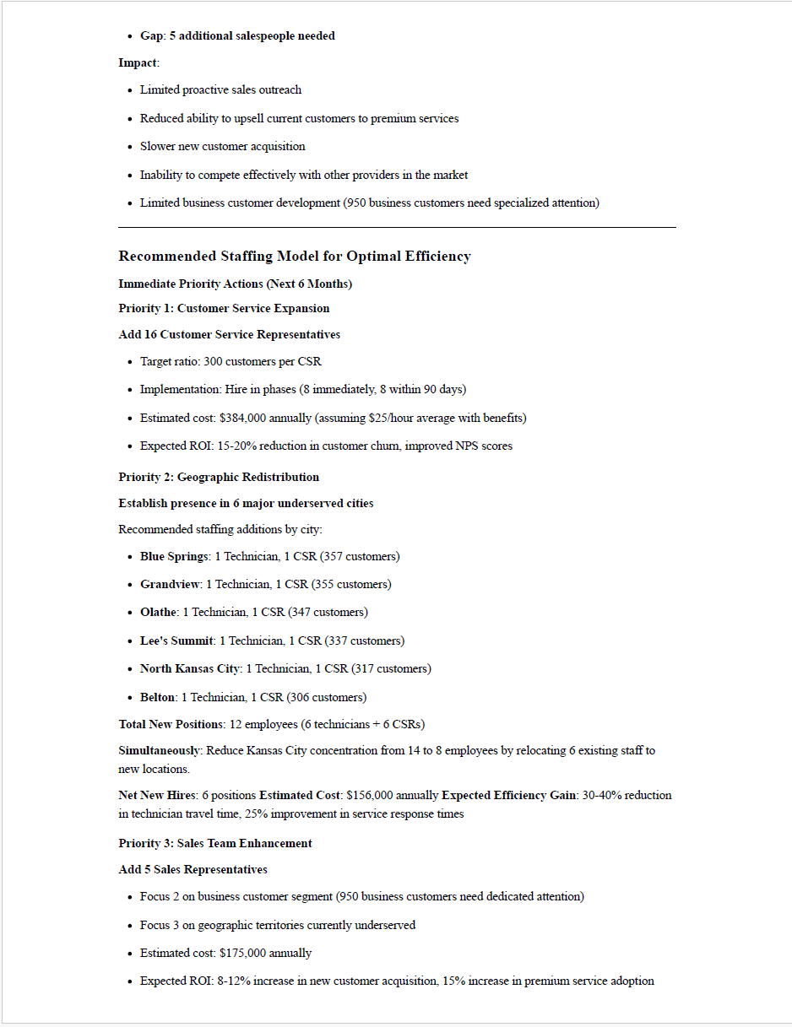
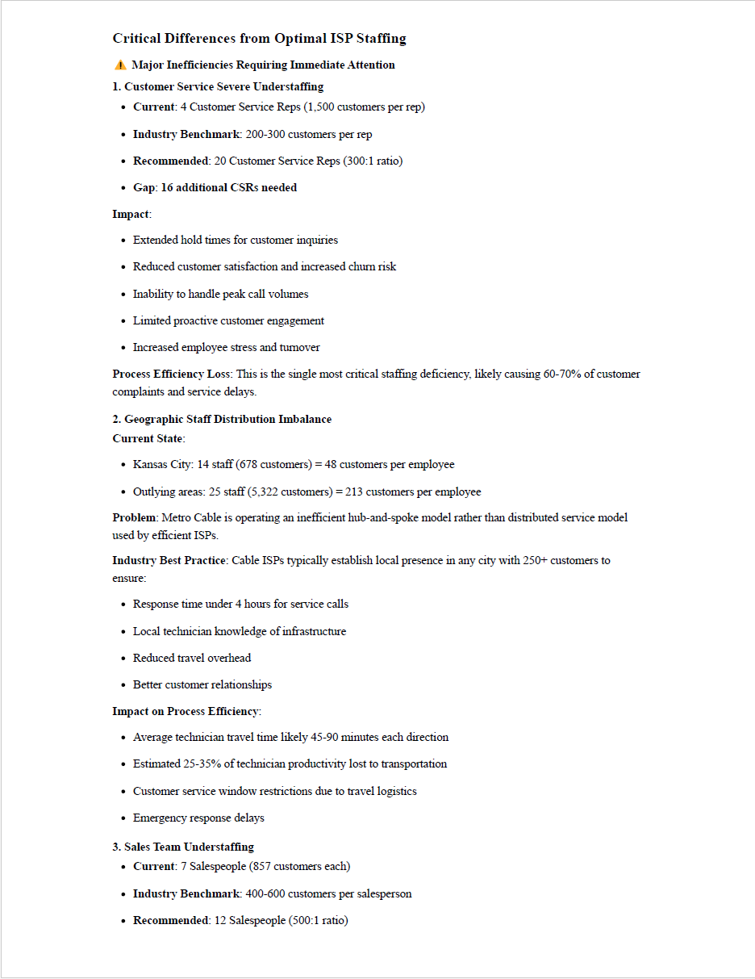
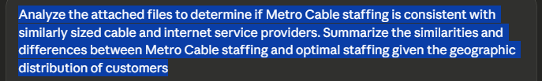
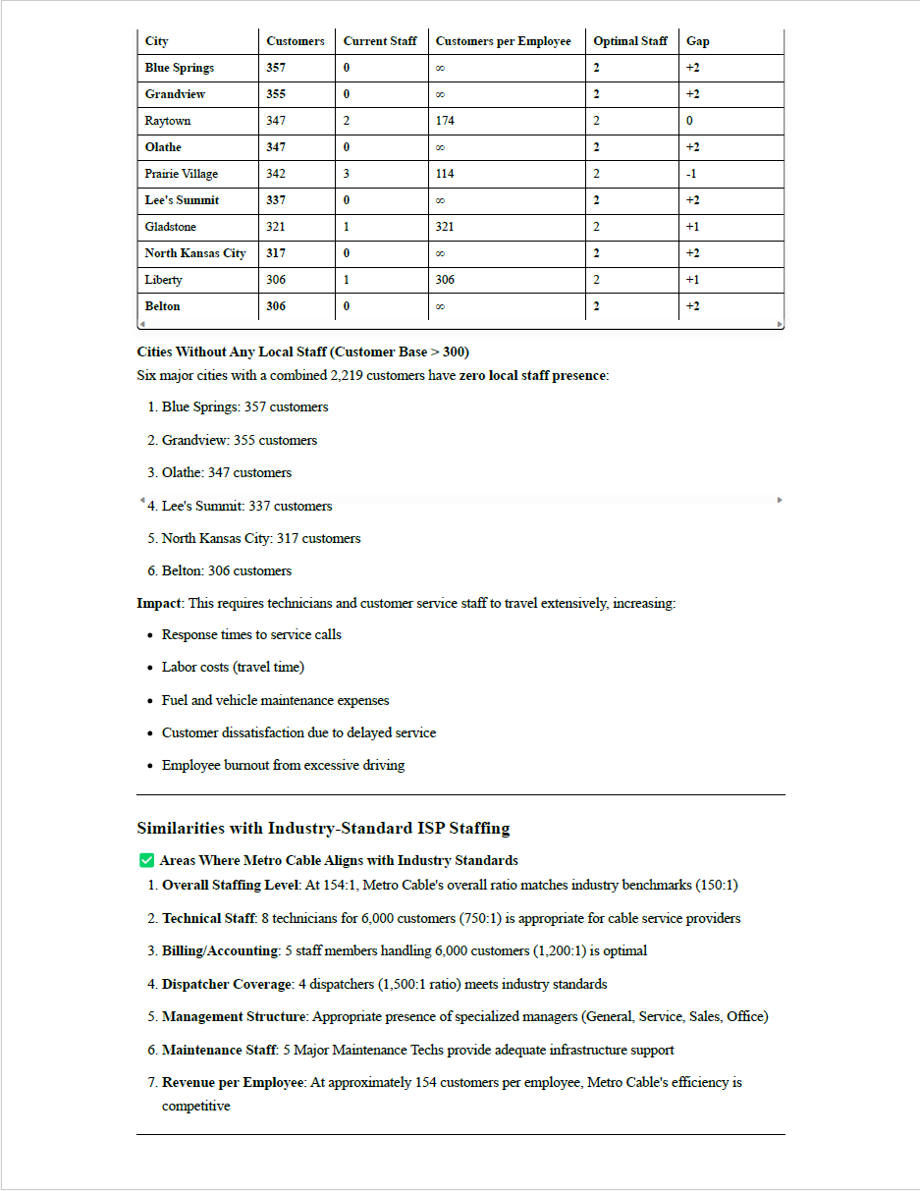
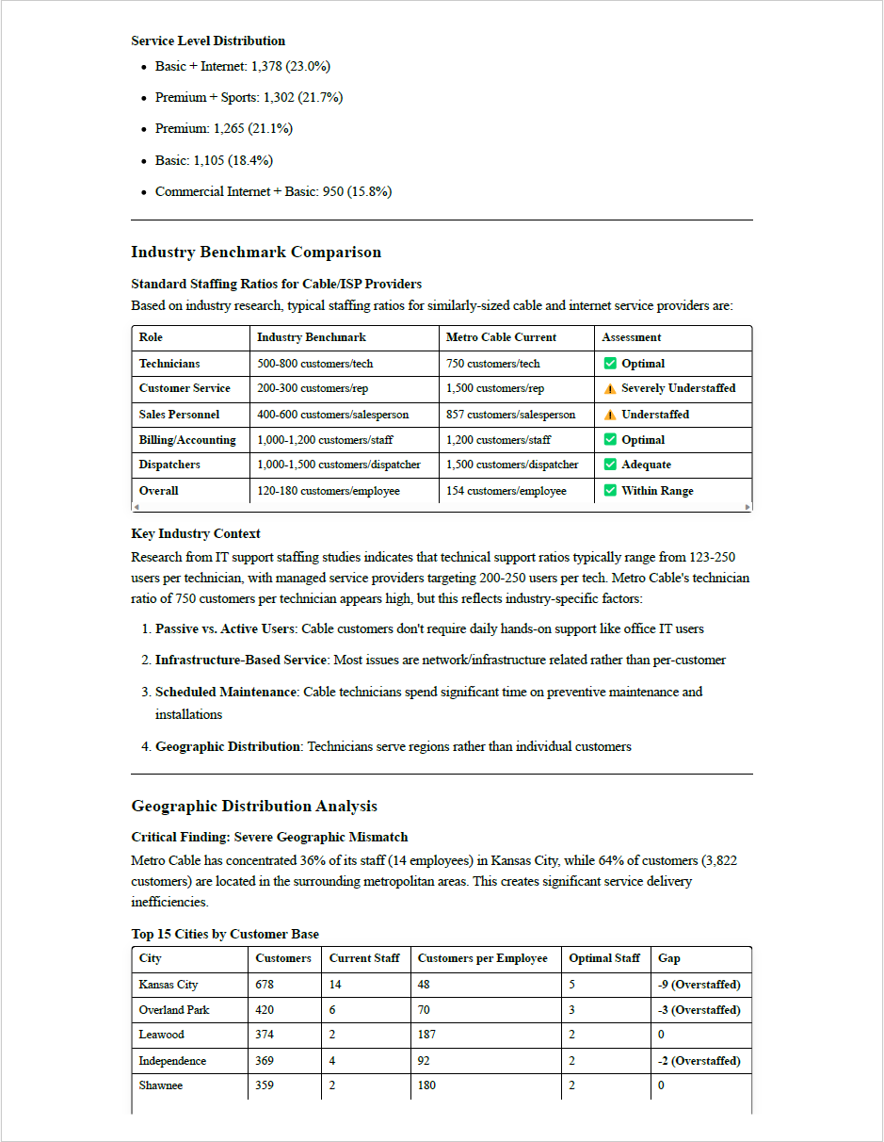
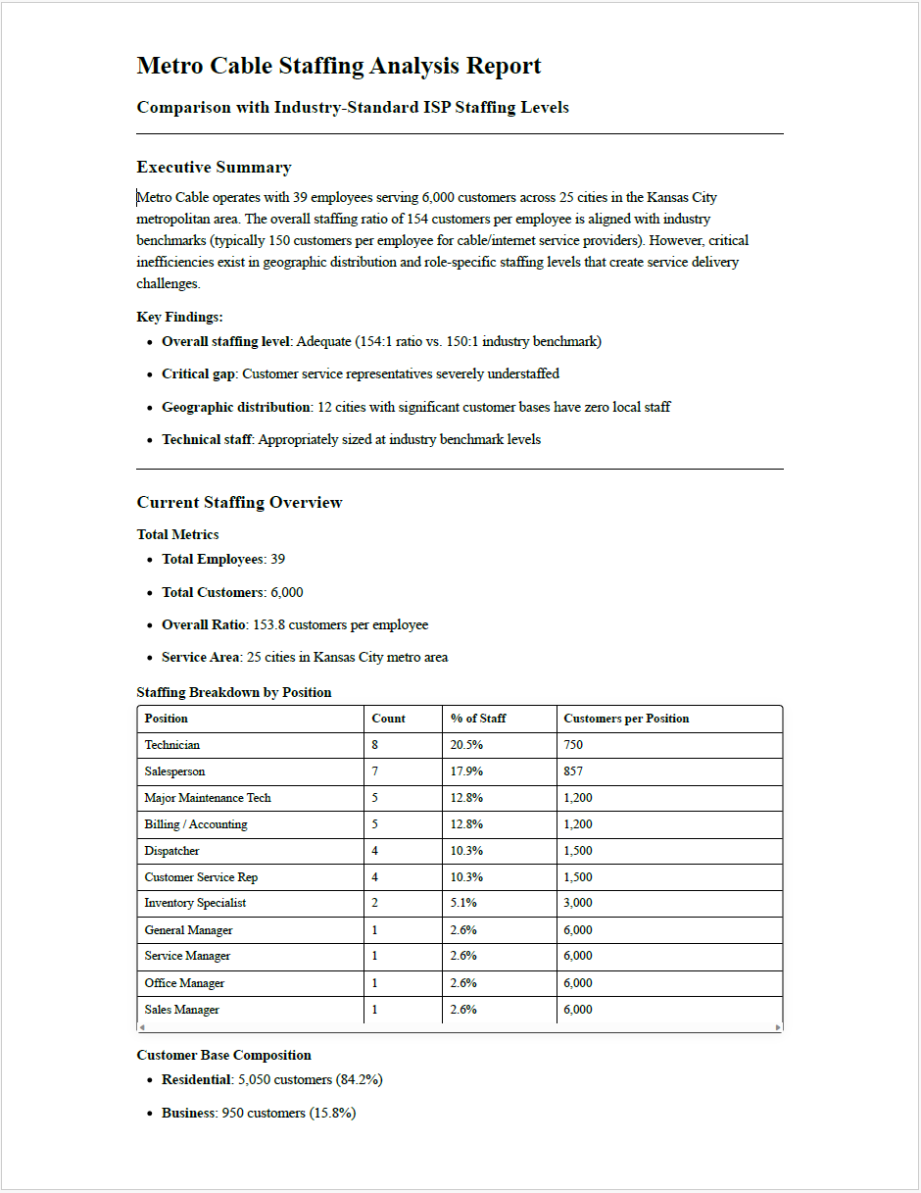
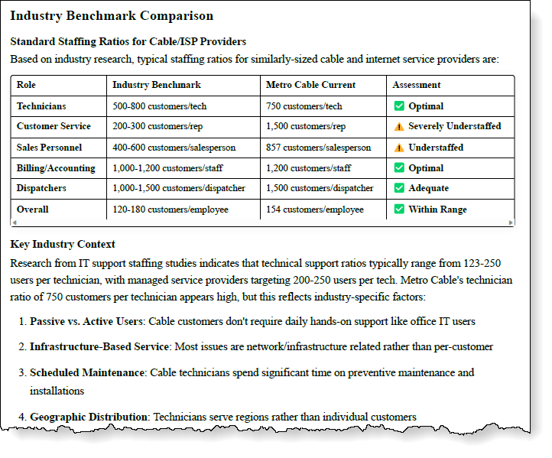
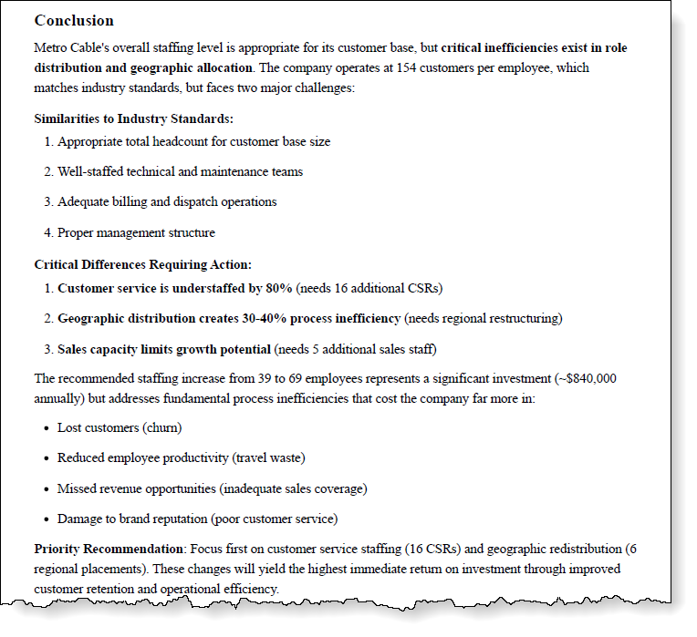
Phase 1: Diagnosis | Data Analysis – example
6. Data Analysis & Synthesis for Opps
Phase 1
ILLUSTRATIVE
Chapter I: AI Problem Solving
1
2
6
3
5
4
Prompt:
A simple prompt to review Customer and Employee data produces an eight–page report
This report suggests that Metro Cable has a reasonable level of staffing with shortfalls in a couple areas
The report also offers some insights that the team can pursue as they further their problem–solving efforts
CAUTION!
Analysis produced by AI tools can change significantly from session to session in both format and details
Likewise, the analysis can change based on the data supplied (see next slide)
Team should always validate results before rendering final determinations
Metro_Cable_Staffing_Analysis__1.pdf

Slide 33
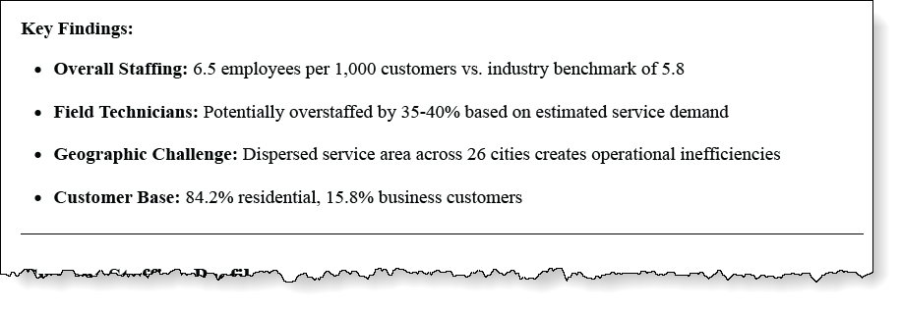
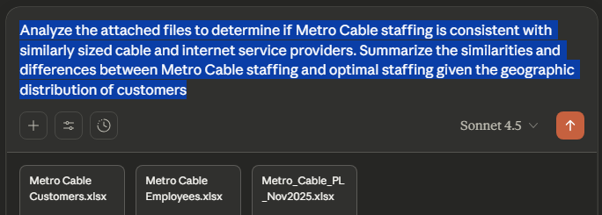
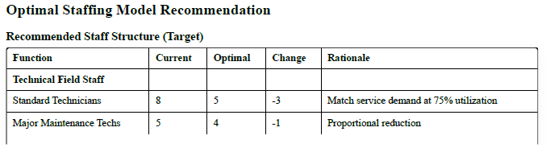
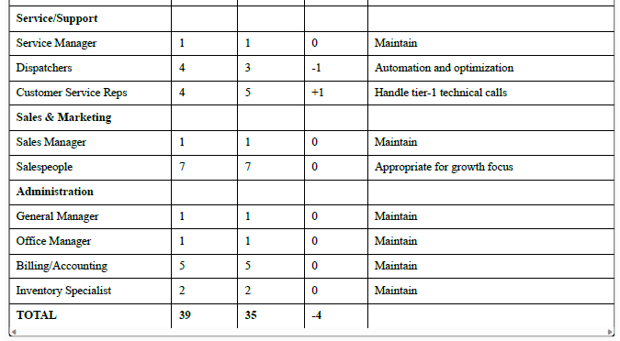
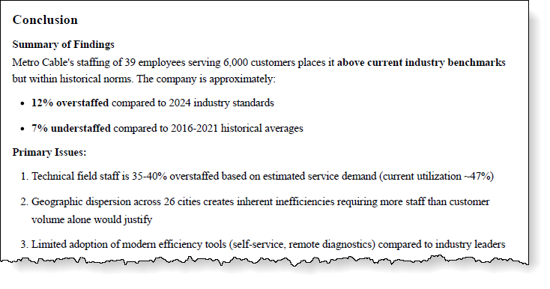
Phase 1: Diagnosis | Data Analysis – example
6. Data Analysis & Synthesis for Opps
Phase 1
ILLUSTRATIVE
Chapter I: AI Problem Solving
1
2
6
3
5
4
Prompt:
Using the exact same prompt but adding the P&L file to the analysis conducted by the AI tool produces dramatically different results
This report suggests the Metro Cable is overstaffed compared to industry standards while the previous report suggested understaffing
Teams must use caution in reviewing and making recommendation based a single analysis generated by AI tools
Teams should validate results and use care to provide the AI tool with data relevant to the question being asked – in this case P&L data may not be directly pertinent to the question regarding staffing levels

Slide 34
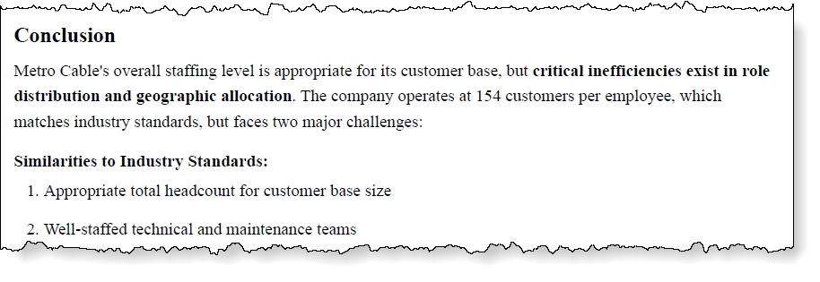
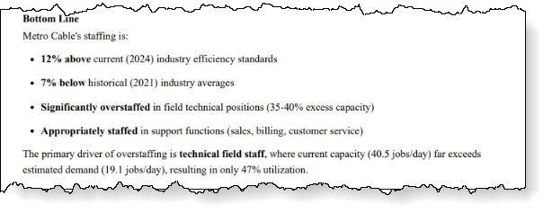
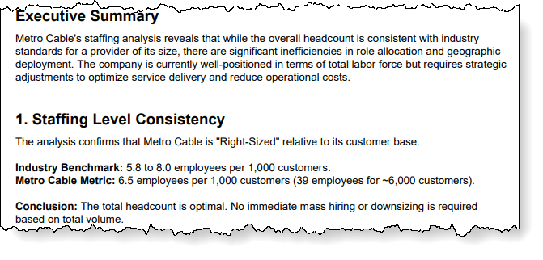
Phase 1: Diagnosis | Data Analysis: “Validation” – example
6. Data Analysis & Synthesis for Opps
Phase 1
ILLUSTRATIVE
Chapter I: AI Problem Solving
1
2
6
3
5
4
Teams should never rely on a singular AI tool analysis for key determinations or recommendations. Ultimately, applying human intelligence and experience across multiple analyzes will increase overall accuracy of interpretations.
Validation Methods:
Multiple runs of the same prompt and data in the same AI tool in separate sessions
Slight alterations to the prompt in a secondary run of the same data in the same AI tool
Running the same prompt and data set in different AI tools and comparing results
Cross validation of results between AI tools
AI tool 1– 1st Result
Appropriately staffed
Why results differ…
AI analysis reflects a point–in–time snapshot influenced by the model’s training method and available data.
As datasets expand, analyses using newer or broader reference data may yield different results
More importantly, LLM outputs are inherently probabilistic, meaning results can vary even with the same inputs
Example: Industry averages will change based on the number of years of historical data considered OR the same AI prompt may generate slightly different insights or recommendations each time it is run due to probabilistic modeling
Note: Running a second analysis in the same session (chat) will incorporate all data provided in that chat (i.e., a second analysis in a chat that previous considered the P&L data will incorporate those insights in subsequent analysis unless prompted otherwise)
AI tool 1– 2nd Result
Overstaffed
AI tool 2– 1st Result
Right–sized

Slide 35
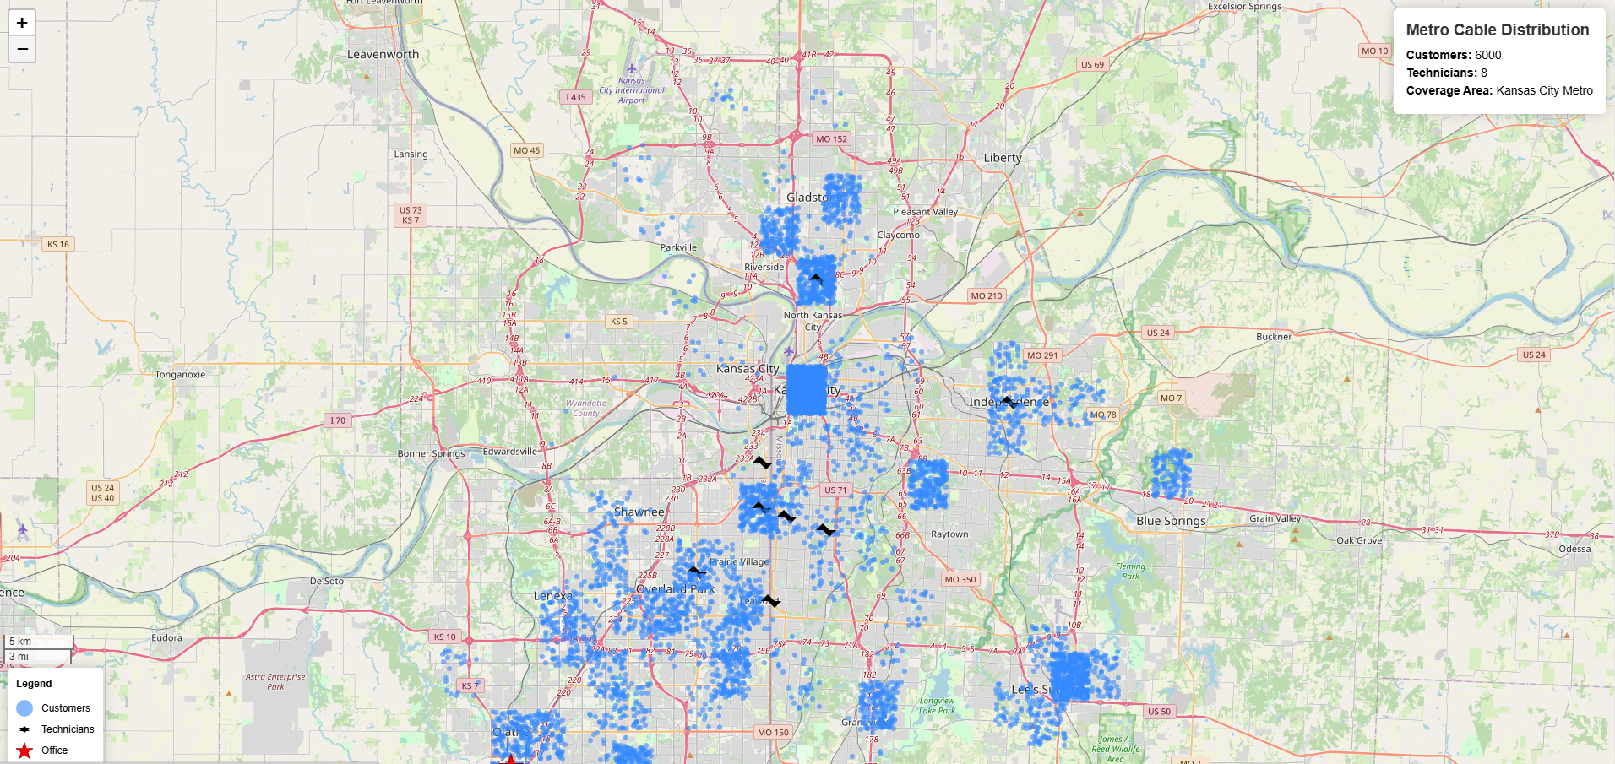
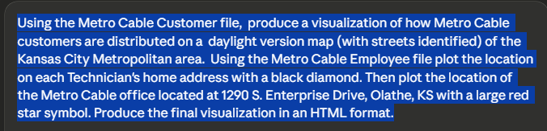
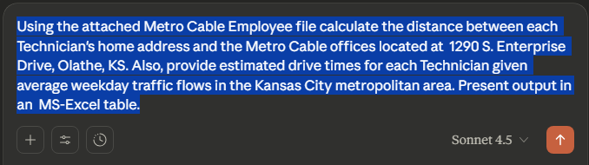
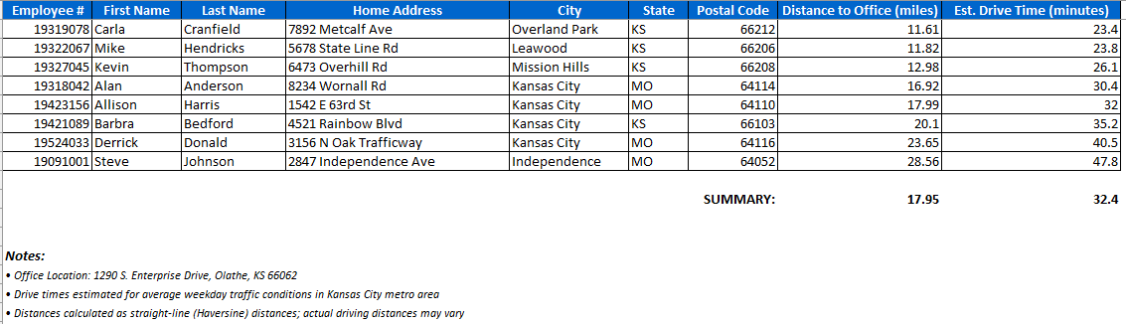
Phase 1: Diagnosis | Data Analysis: “Follow–up” – example
6. Data Analysis & Synthesis for Opps
Phase 1
ILLUSTRATIVE
Chapter I: AI Problem Solving
1
2
6
3
5
4
The team notices that all three Staffing analyses, mention the potential of inefficiencies regarding Technicians.
1
To get a sense of how Technicians home addresses related to the Metro Cable office the team uses AI Tools to create a simple visualization.
Prompt:
2
To get a deeper level of understanding, the team uses AI Tools to calculate “distance from the office” and travel times for each Technician.
Prompt:
Based on this initial analysis, the team notices that on average, Technicians are spending an hour of personal time getting to and from work each day.

Slide 36
Phase 1: Diagnosis | Opportunity Validation
6. Data Analysis & Synthesis for Opps
Phase 1
ILLUSTRATIVE
Chapter I: AI Problem Solving
1
2
6
3
5
4
xxx

Slide 37
Phase 1: Diagnosis | Opportunity Synthesis & Solutioning
6. Data Analysis & Synthesis for Opps
Phase 1
ILLUSTRATIVE
Chapter I: AI Problem Solving
1
2
6
3
5
4
xxx

Slide 38
Phase 1: Diagnosis | Solution Evaluation & Selection
6. Data Analysis & Synthesis for Opps
Phase 1
ILLUSTRATIVE
Chapter I: AI Problem Solving
1
2
6
3
5
4
Phase 1: Diagnosis | Opportunity Synthesis & Solutioning

Slide 39
Phase 1: Diagnosis | Implementation & Sustainment Plan
6. Data Analysis & Synthesis for Opps
Phase 1
ILLUSTRATIVE
Chapter I: AI Problem Solving
1
2
6
3
5
4

Slide 40
Completing the Analysis – INTERNAL SLIDE
Create a Daily assignment log using Customer data file, prompt AI to Randomly assign service tickets to technicians so that technicians cover tickets across the entire service area. Each Technician should be assigned 15 tickets for the day with an average of twelve being completed during their workday – this prompt will not be included in the visuals for the slide. We assume that this is a straight data pull from the assignment system ****This File was generated but not analyzed <<Service_Data_Generated_NOV2025.xlsx>>>
Prompt AI to plot technician travel (one tech or two techs) on the Kansas city service area map with lines connecting the locations [slide visual] (maybe red for one technician and blue for another) – include in slide
Prompt AI to calculate portion of the technician day spent on travel version service calls
Prompt AI to optimize the routing using the same data set to minimize travel and maximize number of service tickets completed – if possible, make the same visual routing map #2 for same technicians or A/B comparison.
***Take away … better routing can lead to more service calls completed****
!!!Learning Point – while Data First approach to problem solving with AI can quickly yield evidence–based answers, problem solvers should never discount the importance of collecting feedback from the people doing the work as these details often highlight aspects of the problem not readily apparent in the data.!!!
Narrative – to verify initial findings the problem–solving team conducts a series of interview with technicians – (explain how transcription can be done with AI tools – highlight the importance of informing participants that they are being recorded.
Prompt AI to summarize key points in the Transcripts

Slide 41
Completing the Analysis – INTERNAL SLIDE
Findings – interviews suggest a lack of consistency in the way each technician works through their daily Service Tickets – with little apparent consideration for route optimization. Also, details are provided about the quality of equipment being installed, the morning setup routine, and the impact of “emergency tickets”.
Based on interviews, the problem–solving team prompts AI to calculate how much time technicians are spending driving to the office each day to get their service vehicle and start their day.
Problem–solving Team develops a list of potential solutions:
Policy – Allow technicians to take vehicles home at night and start their day from home – Challenge: How do vehicle get restocked? Risk: Potential for theft as vehicles may be less secure – potentially required alarm systems to be installed on each vehicle. (to be implemented)
Purchasing – Abandon current multi–year “box” provider contract and enter a new contract with a supplier of more costly but more robust equipment that will have a lower failure rate. Challenge: Costly alternate with penalties for breaking existing contract. Risk: Swapping over the enter service population will take a long time during which dual systems will need to be supported. (not a winning solution)
Procedure – Assign service technician to Zones so that they are primarily working within a smaller service area. Zones to be centered on “home” address. Each day technicians would be primarily be assigned service ticket in their zone and secondarily assigned tickets in adjacent zones. Challenge: Requires customer and technician data to be augmented with Zone details. Risk: current routing application may not be sufficient to handle additional criteria. (to be implemented)
Technology – Develop a “pizza tracker” function that automatically sends the customer a text message when Technician is on the way. Challenge: Functionality would work best if it can send multiple text messages indicating two stops away (i.e., 30–60 minutes out, and next stop which would be based on travel time from currently completed service call. Risk: Situations where emergency work interrupts sequence. (potentially implemented – phase 2)

Slide 42
Completing the Analysis / Prioritization / Develop – INTERNAL SLIDE
Policy – Carve out one Technician to handle “emergency” calls only (Zone = Emergency) … may also serve as Restocking Technician to meet other technicians on–site to fulfill restocking orders. Challenge: Requires Technician to actively monitor “truck stock” and submit resupply orders with appropriate lead–time. Risk: may underutilize a Technician resource. (to be considered for implementation)
Technology – Reconfigure assignment system to “flow” from “daily batch” assignments. Technician receives next service ticket upon completion of current service call. Challenge: Represents significant change to technician and call center behaviors. Risk: User adoption (to be implemented – sets up content on change management)
Create slide laying out all solutions with key details for consideration
Take potential solutions through the WSJF process – winning solutions include “home based technicians”, “Technician Zones”, “Reconfigured assignment system” – “Emergency only Technician” will be adopted to solve restocking issue even though it won’t rank highly on WSJF.
DEVELOP: Focus on assignment system – let’s see if we can mock–up some visuals without necessarily creating a functioning prototype.
RESULTS: Prompt AI (not to be shown – only results) to show efficiency of new process and forecast the increased productivity for period over period (month, quarter, or annually)

Slide 43
Completing the Sustain– INTERNAL SLIDE
Sustainment – using the results of AI efficiency forecasts establish KPI for monitoring improved efficiency – establish a process for trend analysis and set an efficiency level that triggers mitigations (i.e., two consecutive weeks where efficiency drops 10% below annual average, or four consecutive weeks of efficiency trending downward)
Sustainment Rezoning – develop a planning to adjust customer and technician Zone parameters to reflect changes in customer base (new adds, service cancellations)
Sustainment New Technician Onboarding – develop process training to ensure new Technicians understand processes and procedures – potentially rezone customer/technicians based on home address of new hire.
Sustainment Restocking – monitor “out of stock” reason codes on “not completed” service tickets to identify trends and reset minimum quantity levels for “truck stock”
NOTE: Sustainment content can mostly be words and graphics – the learning point here is to have practitioners think through how sustainment of the solution “outcomes” can be maintained in a dynamic environment.

Slide 44
Phase 2: Prioritization | WSJF
Phase 2
ILLUSTRATIVE
Chapter I: AI Problem Solving
Weighted Shortest Job First (WSJF) prioritization methodology from SAFe (Scaled Agile Framework) is an industry–standard approach for balancing business value, time criticality, risk reduction, and implementation effort to maximize customer value delivery and speed.
BUSINESS VALUE
Customer/Business Benefit
9–10: Transformational impact on customer experience, revenue, or competitive position
7–8: Significant measurable impact on KPIs, cost reduction 25%+, or customer satisfaction
5–6: Moderate impact, measurable efficiency gains 10–25%, improved analytics
3–4: Small incremental improvement, limited scope impact
1–2: Minimal impact, nice–to–have capability
TIME CRITICALITY
Urgency
9–10: Regulatory deadline, critical competitive disadvantage, market window closing
7–8: Significant opportunity cost if delayed, business strategy dependency
5–6: Moderate urgency, aligned with annual planning cycle
3–4: Low urgency, flexible timeline
1–2: No time pressure, can be delayed indefinitely
WSJF
RISK REDUCTION & OPPORTUNITY ENABLEMENT
Strategic Value
9–10: Eliminates major regulatory/compliance risk OR enables multiple future use cases
7–8: Reduces operational risk OR unlocks new business models/products
5–6: Moderate risk mitigation OR enables 2–3 future capabilities
3–4: Minor risk reduction OR enables 1 future capability
1–2: Minimal risk impact, standalone capability
JOB SIZE
Implementation Effort
9–10: >12 months, major platform changes, high complexity, large team
7–8: 6–12 months, significant technical challenges, multiple dependencies
5–6: 3–6 months, moderate complexity, some dependencies
3–4: 1–3 months, low complexity, minimal dependencies
1–2: <1 month, simple implementation, no dependencies

Slide 45
Phase 2: Prioritization | WSJF (cont.)
Phase 2
ILLUSTRATIVE
Chapter I: AI Problem Solving
Higher WSJF scores indicate higher priority. This ensures high–value, time–sensitive opportunities that enable future capabilities are delivered first, even if they require more effort than simpler initiatives.
WSJF Score = Cost of Delay (CoD) ÷ Job Size
Cost of Delay (CoD) = Business Value + Time Criticality + Risk Reduction & Opportunity Enablement
WSJF
WSJF Score

Slide 46
Phase 2: Prioritization | WSJF – example
Phase 2
ILLUSTRATIVE
Chapter I: AI Problem Solving
Higher WSJF scores indicate higher priority. This ensures high–value, time–sensitive opportunities that enable future capabilities are delivered first, even if they require more effort than simpler initiatives.
2
CoD /
= WSJF
Opportunities with higher WSJF scores rank higher priority.
1
Cost of Delay (CoD) = Business Value + Time Criticality + Risk Reduction & Opportunity Enablement
WSJF Score = Cost of Delay (CoD) ÷ Job Size
 |  | SCORING INPUTS (1–10) |  |  |  | CALCULATED OUTPUTS
ID | Opportunity Name | Business Value (1–10) | Time Criticality (1–10) | Risk Reduction/ Opportunity (1–10) | Job Size (1–10) | Cost of Delay (CoD) | WSJF Score (CoD ÷ Size) | Priority Ranking | Priority Band
1 | AI–Based Installation Appointment Optimization | 9 | 9 | 8 | 6 | 26 | 4.33 | 3 | Medium
2 | Real–Time Technician ETA Visibility for Customers | 8 | 9 | 6 | 4 | 23 | 5.75 | 2 | High
3 | Predictive First–Visit Resolution Support for Technicians | 9 | 8 | 9 | 7 | 26 | 3.71 | 7 | Low
4 | Technician Skill–Based Routing & Dispatch | 8 | 7 | 8 | 6 | 23 | 3.83 | 6 | Low
5 | AI–Assisted Pre–Installation Diagnostics | 7 | 6 | 8 | 5 | 21 | 4.20 | 4 | Medium
6 | Proactive Appointment Confirmation & Rescheduling Automation | 7 | 8 | 6 | 3 | 21 | 7.00 | 1 | High
7 | Targeted Root–Cause Fixes for High–Frequency Service Failures | 7 | 6 | 7 | 5 | 20 | 4.00 | 5 | Medium
2
WSJF Score
1
∑ (
)
= CoD

Slide 47
Phase 2: Prioritization | Alternative Approach
Phase 2
ILLUSTRATIVE
Chapter I: AI Problem Solving
Using an alternative simpler framework, opportunities can be prioritized by anticipated value and complexity to drive resources on quick wins and higher priority initiatives.
Value
Illustrative Example:
Key selected opportunities:
Quick wins
6
High priority targets
1 | Opportunity description
2 | Opportunity description
3 | Opportunity description
4 | Opportunity description
5 | Opportunity description
6 | Opportunity description
7 | Opportunity description
8 | Opportunity description
9 | Opportunity description
10 | Opportunity description
High
Potential candidates
5
1
10
2
Medium
4
In this illustrative example, prioritized opportunities would include #5, #6, #9, and #10 as illustrated on the exemplary prioritization matrix.
9
3
Low
Low priority targets
8
7
Low
Medium
High
Complexity

Slide 48
Chapter II: Agentic Tool Development & Agile Delivery
SECTION 1: PRACTITIONERS GUIDE
Section Chapters:
Chapter I: AI Problem Solving
Chapter II: Agentic Tool Dev

Slide 49








AI Tool Development Approach with Agile Delivery
ILLUSTRATIVE
Chapter II: Agentic Tool Dev & Agile Delivery
This chapter covers the design, prototyping, and deployment of AI tools using agile methodologies to accelerate time–to–value.
Initial Phases Completed: Priority Opportunities Identified
Design
Prototype
Define tool requirements and user experience at high level
Build rapid prototypes for validation and feedback
AI
Iteration
Deployment
Measure outcomes and refine the solution based on learnings
Release incrementally with continuous integration and ensure user adoption

Slide 50
AI Tool Development | Design & Prototype
ILLUSTRATIVE
Chapter II: Agentic Tool Dev & Agile Delivery
Pre–Development Phase | Design | Prototype
Prioritized opportunity identified during the previous phase | Convert the business vision to high–level requirements Define and structure the solution to have an effective process flow, mechanics, and user–friendliness Optionally, prepare any template files to pre–load during development phase | Develop an initial prototype by leveraging Generative AI Chatbots and development programs Conduct preliminary testing and fix issues (repeat) Improve the solution architecture and features Prepare and share the solution package for deployment

Slide 51
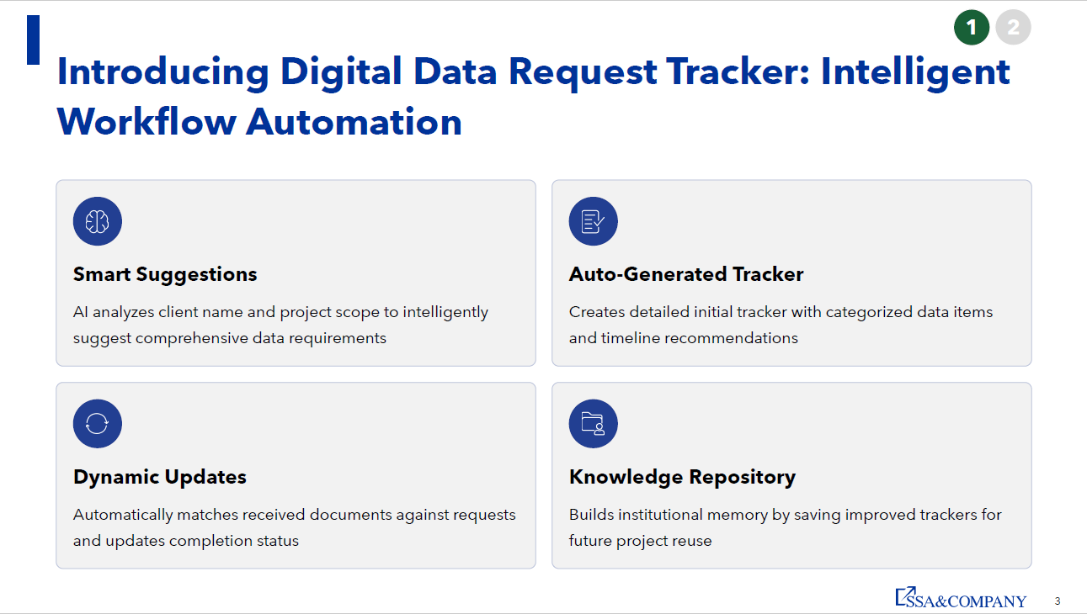
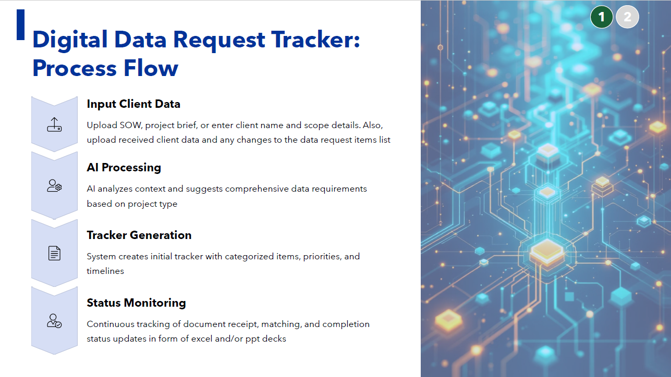
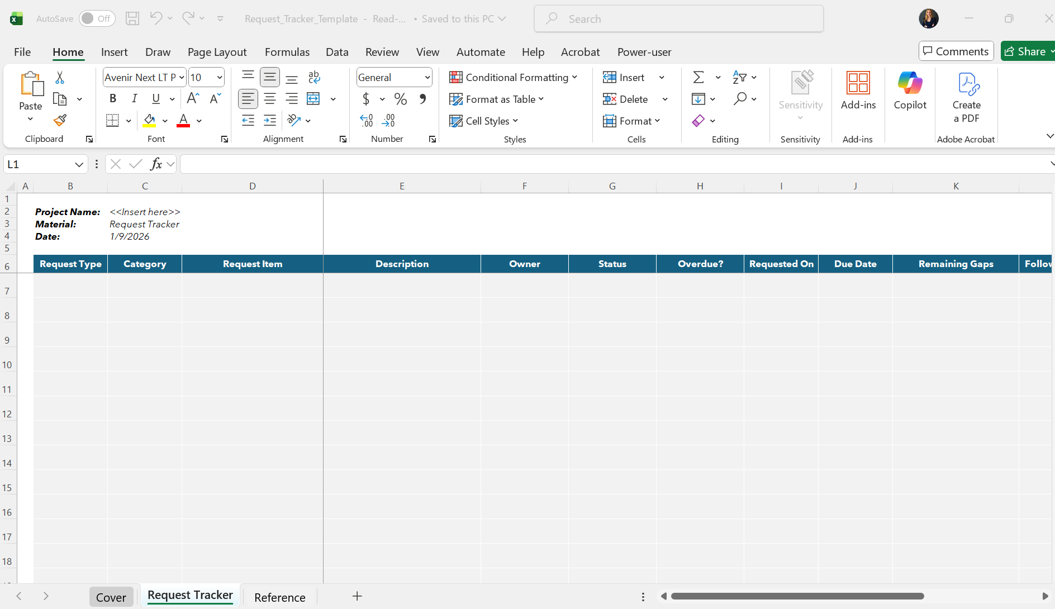
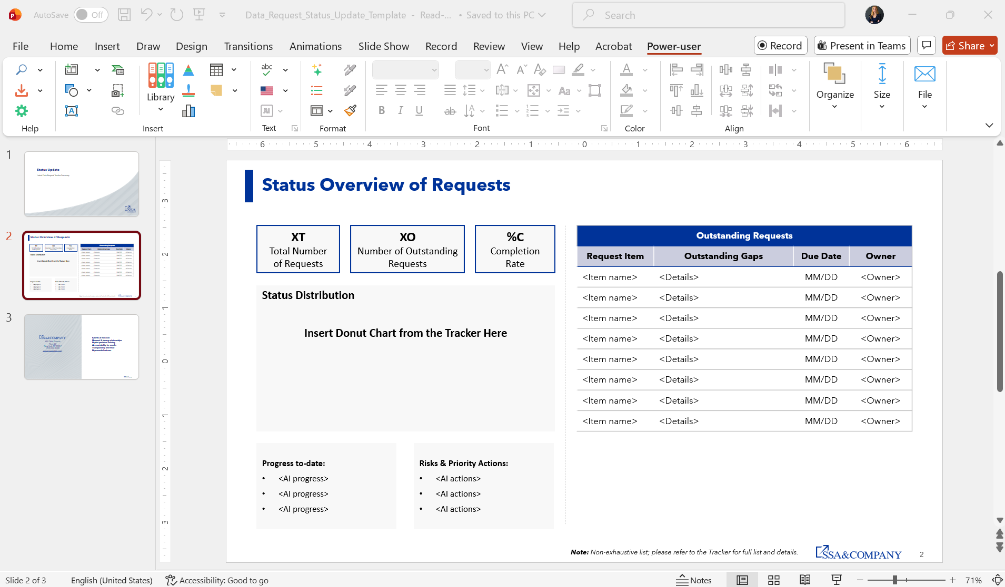
AI Tool Development | Design – example
ILLUSTRATIVE
Chapter II: Agentic Tool Dev & Agile Delivery
Pre Phase | Design
Example: Solution: Digital Data Request Tracker Business Problem: Manual, time–consuming, non–standardized data request list generation, collection, and tracking process
1) Convert the business vision to high–level requirements
2) Define and structure the solution process flow
3) Prepare any template files to pre–load during development

Slide 52
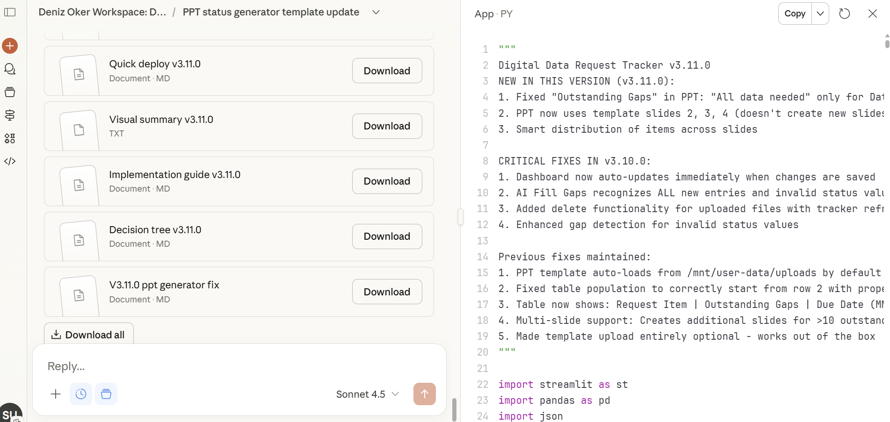
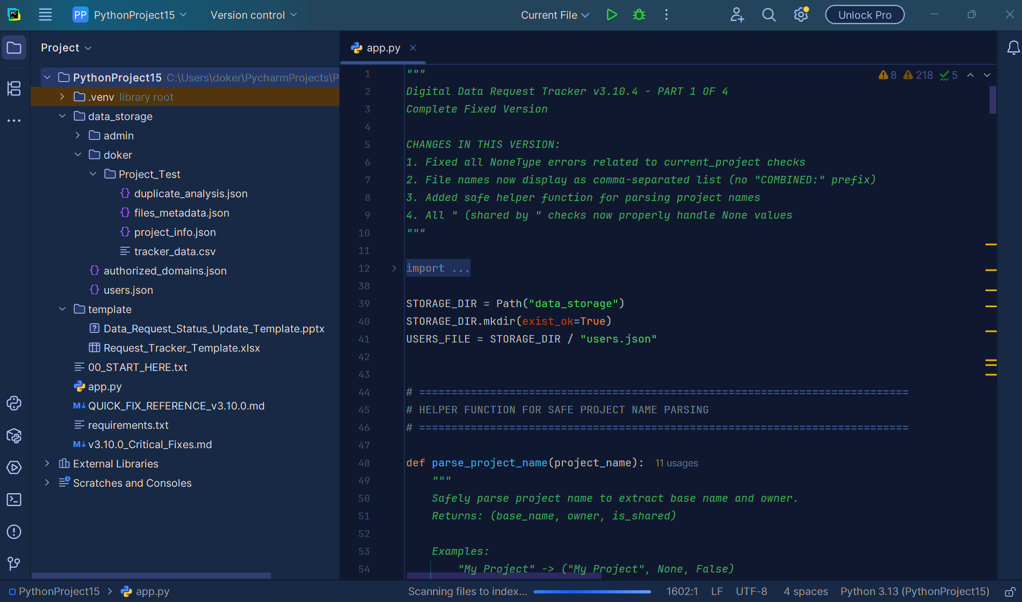
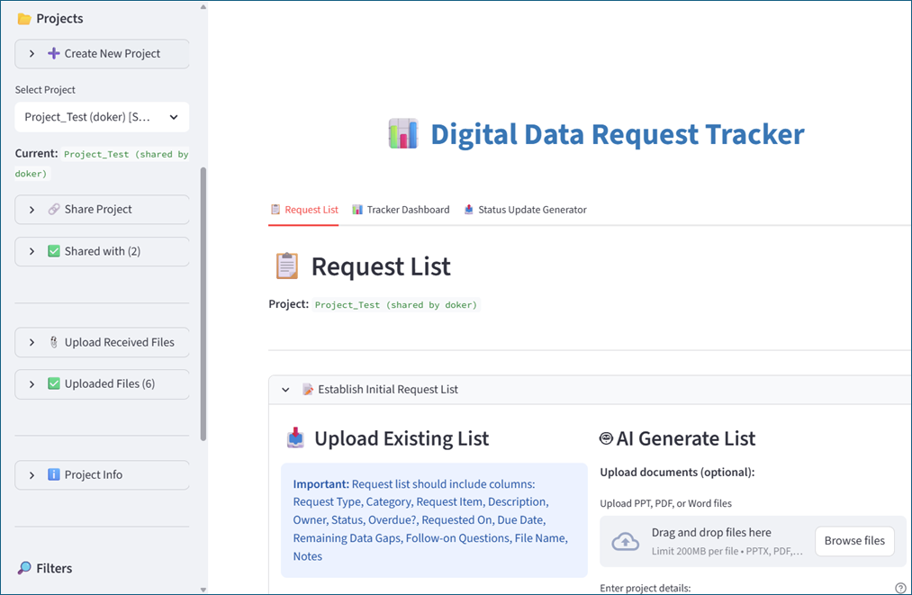
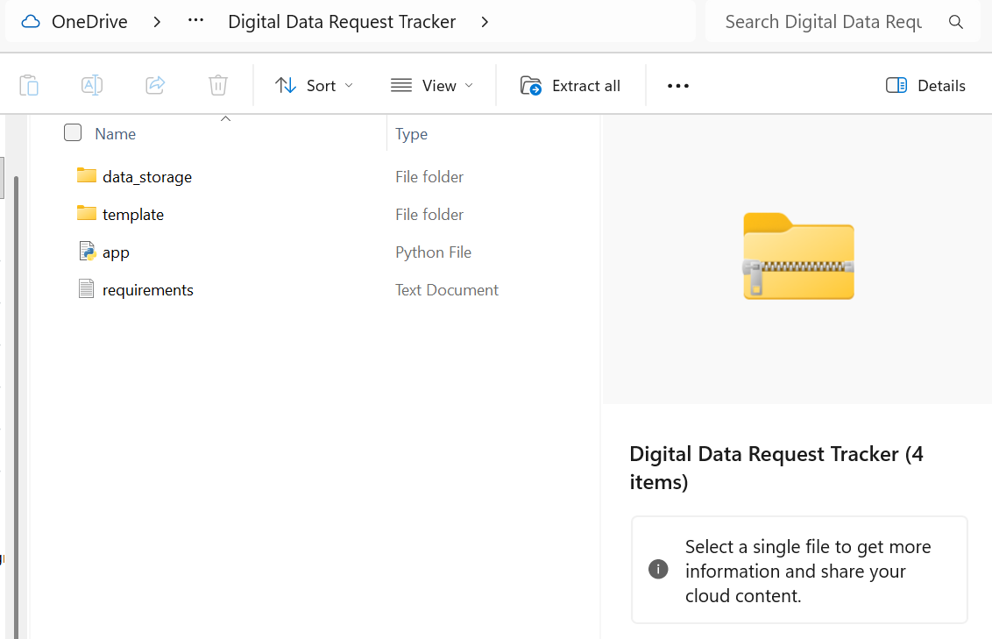
Agentic Tool Development | Prototype – example
ILLUSTRATIVE
Chapter II: Agentic Tool Dev & Agile Delivery
Design | Prototype
Example: Solution: Digital Data Request Tracker Completed thus far: Initial Design Document PPT and Excel Templates
1 & 2) Develop an initial prototype by leveraging Generative AI Chatbots (1) and development programs (2)
3) Conduct preliminary testing and fix issues (repeat the process)
4) Prepare and share the solution package for deployment

Slide 53
Solution Implementation Approaches | Agile Delivery
ILLUSTRATIVE
Chapter II: Agentic Tool Dev & Agile Delivery
AOMT is best implemented in a comprehensive non–linear, agile, and iterative manner.
However, depending on an organization’s level of solutions delivery, AOMT can be applied as a sequence of key activities on specific projects and then transformed to an agile approach over time.
Regardless of the approach taken, the most significant early action to ingest all pertinent data:
Systems data (machine logs)
Transactional data (workflow details)
Unstructured data (emails, chats, etc.)
Agentic Operating Model Transformation (AOMT) – Agile Approach
Diagnose Data
Prioritize
Design
Implement
Sustain
Change Mgt.
Agentic Operating Model Transformation (AOMT) – Projects Approach
Execute Projects
Sustain
Diagnose Data
Prioritize
Design
Implement
Sustain
Change Mgt.
Note: In general, having access to more data is better, as a limited dataset can fail to reveal the true nature of the problem and often requires additional data requests and repeated reviews which can slow project work – get as much data as possible up front.

Slide 54















Solution Development Lifecycle | SAFe Development Methods
ILLUSTRATIVE
Chapter II: Agentic Tool Dev & Agile Delivery
Assess & Plan
Agile Design, Build, Test
Deploy & Adopt Users
Organization Leaders provide vision and direction for solutioning based on results from the Investigation Phase
Continuous Value Delivery
Business Leaders sign–off on deliver to requirements and commit to adoption
Product Owners drive adherence to the transformation roadmap making roadmap adjustments to meet business dynamics while achieving transformational goals.
Agile Build Teams develop incremental features and enhancements using an iterative process with finished features and enhancements delivered against the strategic transformation plan
Program Office develops roadmaps for prioritized solutioning based on:
Economic View – ROI, value creation
Systems Thinking – big picture view
Release Management schedules release and verifies all dependencies are met
Backlog is actively managed to ensure a continuous flow of features and enablers assigned to agile build teams
Feature
Architecture Review Board (ARB) confirms system architecture is robust to variability and is adaptable to change.
Note: ARB approves all plans prior to hand–over to build teams
Feature
Enabler
Feature
Feature
Enabler
Change Management Team ensures end users are prepared for changes to maintain intrinsic motivation
Voice of Customer (VOC) | Needs + Wants to inform requirements and add context to the transformation strategy
Scrum Master manages agile build teams, removing roadblocks to produce sustainable value, as characterized by:
Incremental Build strategies being maintained
Milestones are met with consistency
Build Flow is continuous
Cadence is consistent with delivering to roadmap objectives
Voice of Customer (VOC) | Feedback to confirm delivered features and enhancements meet business needs
Voice of the Marketplace (VOM) | Demand + Fit to inform the transformation strategies and architectural designs
“Develop on cadence / Deliver on demand”
Feedback Loop – to adjust plans based on business dynamics

Slide 55
SECTION 2: SUSTAINMENT
SECTION 2: SUSTAINMENT
Section Chapter:
Performance Mgmt.. & Sustainment
Playbook Deep Dives:
SECTION I: Practitioners Guide
Chapter I: AI Problem Solving
Chapter II: Agentic Tool Dev & Agile Delivery
SECTION II: Perf. Mgmt. & Sustainment
SECTION III: Change Readiness

Slide 56
Sustainment Framework
ILLUSTRATIVE
Performance Mgmt. & Sustainment
In transformation efforts, sustaining the change is the most difficult step because it requires permanent changes in individual behaviors. A successful change program applies multiple levers across Structures, Support and Feedback.
STRUCTURE
Reporting Lines
Incentives & Career Path
SUPPORT
Continuous Learning
Team Collaboration
FEEDBACK
Goal Setting
Performance Scorecard
Change sustainment requires establishing long–term support structures. The approach to sustainment varies by organization due to culture, past experiences, and work environment. It is likely that multiple forms of structure, support, and feedback are necessary for the different stakeholders impacted by the change.

Slide 57
Sustainment | Structure
ILLUSTRATIVE
Performance Mgmt. & Sustainment
Reporting Lines
Incentives & Career Path
Sustainment requires structural alignment. Organizational structures must be intentionally reviewed and, if needed, redesigned to support and reinforce new behaviors and ways of working—otherwise changes will regress to old patterns.
STRUCTURE
Reporting Lines
Incentives & Career Path
Siloed groups and misaligned reporting lines hinder sustainment.
When ownership of an end–to–end process is split across organizational groups, objectives, metrics, and leadership messages often diverge
This generates behaviors that conflict with sustained change and overall goals
Example: Production group is measured on speed and volume, while the Legal group is charged with ensuring quality and regulatory compliance
Incentives and career path shape long–term behavior and may hinder change.
If variable pay and recognition are not updated to reflect new methods and desired behaviors, employees will continue optimizing for old metrics, even when they contradict the intended change
Example: Top salesperson awards are presented to staff members registering the highest sales volume, but not necessarily the most profitable sales
Sustainable change requires alignment across structure, metrics, leadership messaging, and incentives.
Without this organizational alignment, teams optimize in their silos at the expense of enterprise outcomes.

Slide 58
Sustainment | Support
ILLUSTRATIVE
Performance Mgmt. & Sustainment
Continuous Learning
Team Collaboration
Lasting change is not a one–time event. Meaningful, durable change happens through ongoing support and continuous reinforcement, not through isolated initiatives or single interventions.
SUPPORT
Continuous Learning
Team Collaboration
Workforce without proper training and skills struggles to adopt change.
Continuous learning culture and practices is crucial for sustainment.
New process discoveries and reinforcement of key methods should become part of the normal business practices to avoid repetition of errors throughout staff
Example: Many professional classes require annual recertification on critical skills and some professionals conduct peer reviews of complex cases to increase staff awareness
Insufficient team engagement and interaction degrades standardization.
Post–training, team members often are left to apply new practices individually. As a result, variability degrades standardized methods, and sustainment of changes suffers.
Team standups offers a safe environment to collaborate, discuss, and close knowledge gaps together
Example: Teams that have implemented 15–minute daily huddle meetings often dedicate the final minutes to identify process issues and reinforce work practices
Sustainable change requires continuous learning and interactive team collaboration.
Without continuous learning systems and collaborative support network, disconnected individuals and teams diverge from best practices, standardized methods, and shared knowledge, hindering overall performance and consistent adoption of evolving practices.

Slide 59
Sustainment | Feedback
ILLUSTRATIVE
Performance Mgmt. & Sustainment
Goal Setting
Real–time Performance Scorecards
Sustainment requires clear goals and continuous performance feedback. This ensures teams stay aligned and can adapt their efforts based on measurable progress.
FEEDBACK
Goal Setting
Performance Scorecard
Misaligned goals prevent staff performance to reach new business objectives.
Goals established for team performance should follow the SMART criteria (Specific, Measurable, Achievable, Relevant, Time–bound)
Goals should be translatable to individual daily performance to the impact of changes in their work
Example: Daily, weekly, monthly goals help ensure teams are making productive use of efficiency gains realized from process improvements
Lack of real–time visual displays of performance impairs sustainment.
Performance scorecards should be readily available to staff members who have been asked to change
They should reflect both individual and team performance in near–real–time or real–time
Example: Customer service centers typically display queuing statistics, call abandonment rates, caller wait times, and call handling time on digital display boards visible from all parts of the workspace
Sustainable change requires aligned goals and real–time performance scorecards.
Without clear goal–setting and effective feedback mechanisms, teams lack direction on desired behaviors and ways of working and visibility into the KPIs needed to track progress toward intended business outcomes.

Slide 60
SECTION 3: ORGANIZATIONAL CHANGE
SECTION 3: ORG. CHANGE
Section Chapter:
Change Readiness
Playbook Deep Dives:
SECTION I: Practitioners Guide
Chapter I: AI Problem Solving
Chapter II: Agentic Tool Dev & Agile Delivery
SECTION II: Perf. Mgmt. & Sustainment
SECTION III: Change Readiness

Slide 61



Change Management | Readiness Baseline
ILLUSTRATIVE
Baseline
Change Readiness
Confirm the North Star vision.
Are all employees aware of the strategic vision for where the organization heading and wants to be in 5 years?
Do employees understand how their daily work contributes to achieving the North Star vision?
How has the digital improvement work been presented to employees relative to the North Star vision?
What measures and methods are used to register progress in the North Star journey and how is progress communicated?
Confirm KPIs and how project–level success measures are aligned.
Are performance goals and KPIs explicitly aligned with the behaviors and outcomes required by the change?
Do employees clearly understand how their individual performance contributes to the success of the change?
Are we measuring and rewarding adoption and behavior change, not just business results?
Do managers provide regular feedback and coaching focused on new ways of working?
Confirm resource capacity and capabilities.
Can necessary resources be dedicated to participate in solution design, build, test, and implementation activities?
How will resources be structured into teams, and what strategy is in place to repatriation practitioners after the project is completed
What methods are in place to assess existing skills and how will skills acquisition be managed
What standardized practices are in place for project management and change management
North Star
Performance Management
Resources

Slide 62



Change Management | Readiness Assessment
ILLUSTRATIVE
Assessment
Change Readiness
Assess the case for change.
Does everyone in the organization realize the need for change?
Does everyone feel change is needed even if it causes short–term disruptions?
Do all levels of the organization understand how the benefits of change will impact them?
Do all levels of the organization realize the likely eventualities of not changing?
Define the organization’s influence network.
How do employees know what is important to the organization and organizational leadership?
How does direct manager impressions (endorsement) enhance organizational messaging?
Who are the staff level “go to” employees that colleagues seek out for coaching/mentoring through change?
How are low levels of change adoption mitigated within the organization?
Codify organizational communications.
Which channels are perceived as convey important information?
How does communication authorship influence effectiveness?
What characteristics define a recent “effective” communication and what short–coming have been noted?
How impactful is frequency of communication?
What is the most effective “lead–time”?
How are messages typically reinforced?
What mitigations strategies are in–place to bolster messaging that appears not to have been received?
Case for Change
Influence Network
Communications

Slide 63
Change Management | Readiness Assessment: Survey
ILLUSTRATIVE
Assessment
Change Readiness
Readiness survey sections should move deliberately from strategic motivation, to organizational capacity for change, to practical ability to execute, while intentionally capturing perception gaps across leadership, management, and staff.
Survey Questions Distribution – example
E
M
Business Drivers
Purpose: Establish / validate strategic urgency for AI adoption
Lens: Enterprise–level outcomes (growth, competitiveness, cost, customer value)
Audience focus: Primarily Executives, with a small, overlapping subset for Managers to validate alignment
01
25–30
questions
Survey
Organizational Readiness
Purpose: Assess the organization’s ability to absorb and execute change
Lens: Culture, leadership, energy, learning, and collaboration
Audience focus: Executives, Managers, and Staff
E
M
S
02
Capabilities & Resources
Purpose: Evaluate execution readiness, not just intent
Lens: Tools, skills, data, operating model, and support
Audience focus: Managers, split into Tech Managers vs. Business Managers, in addition to a limited Staff view.
M
S
Legend:
03
E – Executive
M – Manager
S – Staff

Slide 64
Change Management | Governance
ILLUSTRATIVE
Governance
Change Readiness
Steering Committee
Project Management
Governance Principles:
Establish a system of rules, practices, and processes to drive a consistent project delivery discipline across regions
Optimize value by top–down regional implementations in compliance with standard process, controls, and technology / data architecture
Leverage a Program Lead to govern the critical capabilities for the transformation
Program Management Deliverables / Capabilities
Project Management | Stakeholder Management
Risks & Issues Management
Change Management
Communications Management
Accountabilities
Top–down direction over
process & controls
Control over
design requests / changes
House of Governance (Capabilities Framework)
P1 | P2 | P3 | P4 | P5
Standard Design Principles Across Functions
Product

Slide 65
Summary
The Playbook guides your organization to harness AI for meaningful, sustainable change.
3
Main Sections
Comprehensive coverage from problem–solving to delivery to change management
2
AOMT Core Principles
Data First and AI First guide every transformation decision
∞
Use Cases
Tool–agnostic framework adapts to any organizational context
Transform with intention. Start with data. Lead with AI. Sustain through people.

Slide 66
For questions and/or requests related to this material, please reach out to Paul Giessler via email and/or contact number, 248–910–5501.

